Slide 1
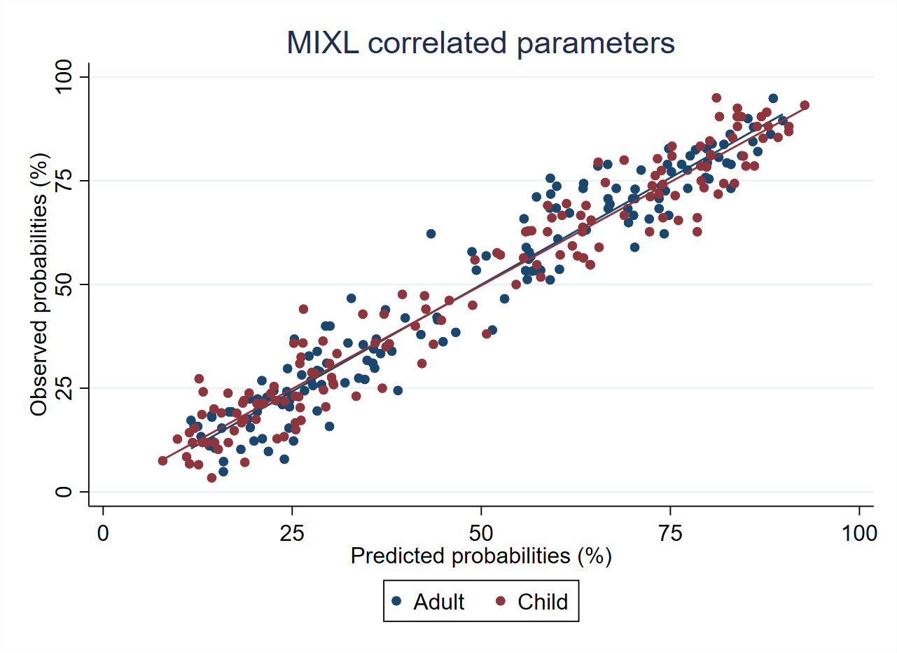
Methodological comparisons of preferences towards EQ-5D-Y health states between adult own and child perspectives in Hong Kong
Ivan Au, The University of Hong Kong, Hong Kong Zhihao Yang, Guizhou Medical University, China
Fredrick Dermawan Purba, Universitas Padjadjaran, Indonesia Alex Suen, The University of Hong Kong, Hong Kong
Nan Luo, National University of Singapore, Singapore Carlos Wong, The University of Hong Kong, Hong Kong
Aim: obtain preferences towards EQ-5D-Y health states in Hong Kong, understand the differences in preferences between the adult own perspective and a hypothetical 10-year-old child perspective.
Introduction:
International valuation protocol for the EQ-5D-Y has been published by the EuroQol Group with 2 recommend techniques, DCE and C-TTO
Valuing child health is challenging
In current method, it was decided to use adult respondents
Evidence is lacking in Asian countries
To create value set for Hong Kong, and compare with other study done in the region (Japan & Slovenia)
Method:
Task done by recruiting 1000 and 200 respondents respectively, from adult general population in Hong Kong, to value EQ5DY health states (DCE & C-TTO)
EQ-PVT platform used to interview 2 groups of 500 respondents, completing 15 pairs of DCE tasks from adult perspective and 10-year-old child respectively
EQ-VT platform for C-TTO, interviewed 200 respondents to complete the standard valuation survey from a child perspective
Latent DCE values were then converted to a 0 (death)/ 1 (full health) scale by mapping them to the C-TTO values
Hybrid model with command ‘hyreg’ 1) using C-TTO data and all DCE data; 2) using C-TTO data and DCE data from adult perspective; and 3) using C-TTO data and DCE data from child perspective were analyzed
Sensitivity analysis was conducted using mixed logit model (MIXL)
Results:
Table. 1 C-TTO descriptive results
Table. 2 Regression results
Fig. 1 Calibration plot
Profile | Observed |  | Censoring-adjusted
 | Mean | SE | Mean | SE
11112 | 0.939 | 0.009 | 0.939 | 0.009
11121 | 0.933 | 0.008 | 0.933 | 0.008
21111 | 0.922 | 0.008 | 0.922 | 0.008
22223 | 0.590 | 0.028 | 0.588 | 0.028
22232 | 0.400 | 0.035 | 0.392 | 0.037
31133 | 0.268 | 0.037 | 0.254 | 0.040
32223 | 0.430 | 0.032 | 0.424 | 0.033
33233 | 0.005 | 0.039 | -0.023 | 0.044
33323 | 0.031 | 0.040 | 0.009 | 0.043
33333 | -0.173 | 0.039 | -0.227 | 0.047
EQ-5D-Y dimension | Model parameters | Overall (N = 1,000) |  |  | Adult Perspective (N = 500) |  |  | Child Perspective (N = 500)
 |  | Coeff | 95% CI | P-value | Coeff | 95% CI | P-value | Coeff | 95% CI | P-value
Mobility (walking about) | I have some problems walking about | -0.053 | (-0.064, -0.043) | <0.001 | -0.060 | (-0.073, -0.046) | <0.001 | -0.060 | (-0.074, -0.047) | <0.001
 | I have a lot of problems walking about | -0.201 | (-0.212, -0.191) | <0.001 | -0.197 | (-0.212, -0.183) | <0.001 | -0.215 | (-0.228, -0.203) | <0.001
Looking after myself | I have some problems washing or dressing myself | -0.036 | (-0.047, -0.024) | <0.001 | -0.032 | (-0.048, -0.016) | <0.001 | -0.044 | (-0.059, -0.029) | <0.001
 | I have a lot of problems washing or dressing myself | -0.146 | (-0.156, -0.136) | <0.001 | -0.155 | (-0.169, -0.141) | <0.001 | -0.139 | (-0.153, -0.126) | <0.001
Doing usual activities | I have some problems doing my usual activities | -0.066 | (-0.075, -0.056) | <0.001 | -0.063 | (-0.076, -0.049) | <0.001 | -0.072 | (-0.084, -0.059) | <0.001
 | I have a lot of problems doing my usual activities | -0.222 | (-0.231, -0.213) | <0.001 | -0.222 | (-0.235, -0.209) | <0.001 | -0.217 | (-0.229, -0.205) | <0.001
Having pain or discomfort | I have some pain or discomfort | -0.071 | (-0.080, -0.062) | <0.001 | -0.064 | (-0.076, -0.052) | <0.001 | -0.075 | (-0.086, -0.064) | <0.001
 | I have a lot of pain or discomfort | -0.229 | (-0.243, -0.215) | <0.001 | -0.223 | (-0.241, -0.204) | <0.001 | -0.234 | (-0.252, -0.217) | <0.001
Feeling worried, sad, or unhappy | I am a bit worried, sad or unhappy | -0.057 | (-0.066, -0.047) | <0.001 | -0.054 | (-0.066, -0.041) | <0.001 | -0.062 | (-0.074, -0.050) | <0.001
 | I am very worried, sad or unhappy | -0.191 | (-0.202, -0.180) | <0.001 | -0.190 | (-0.205, -0.175) | <0.001 | -0.189 | (-0.203, -0.175) | <0.001
In all collected C-TTO data, no interviewer or C-TTO interviews were excluded during quality control process.
Observed mean/censoring-adjusted mean of C-TTO values were 0.939/0.939 for [11112] and -0.173/-0.227 for [33333].
Our hybrid models (including C-TTO data with (1) overall DCE responses, (2) DCE responses from adult perspective, or (3) DCE responses from child perspective) estimated the statistically significant coefficients for all model parameters
Largest coefficients for model parameter was “I have a lot of pain or discomfort”, Overall: -0.229, 95%CI -0.243 to -0.215; Adult perspective: -0.223, 95%CI -0.241 to -0.204; Child perspective: -0.234, 95%CI -0.252 to -0.217
Results were in line with the EQ-5D-Y value set in Japan and Slovenia
Sensitivity analysis applying mixed logit model yielded similar finding as our main analysis.
Discussion & Conclusions:
Rank order of five dimensions was ‘having pain or discomfort’, ‘doing usual activities’, ‘mobility’, ‘feeling worried, sad, or unhappy’, and ‘looking after myself’, which was different from rank order of EQ-5D-5L value set in Hong Kong (mobility, pain/discomfort, self-care, anxiety/depression, usual activities).
In this study, we presented preliminary evidence on the EQ-5D-Y value set in Hong Kong, and preference for EQ-5D-Y health states between the adult and child perspectives.
There was no remarkable difference in preference between valuation perspectives, in contrast to previous studies in Euro. Due to the reason that both valuation perspectives were not administered to the same participant.

