Slide 1
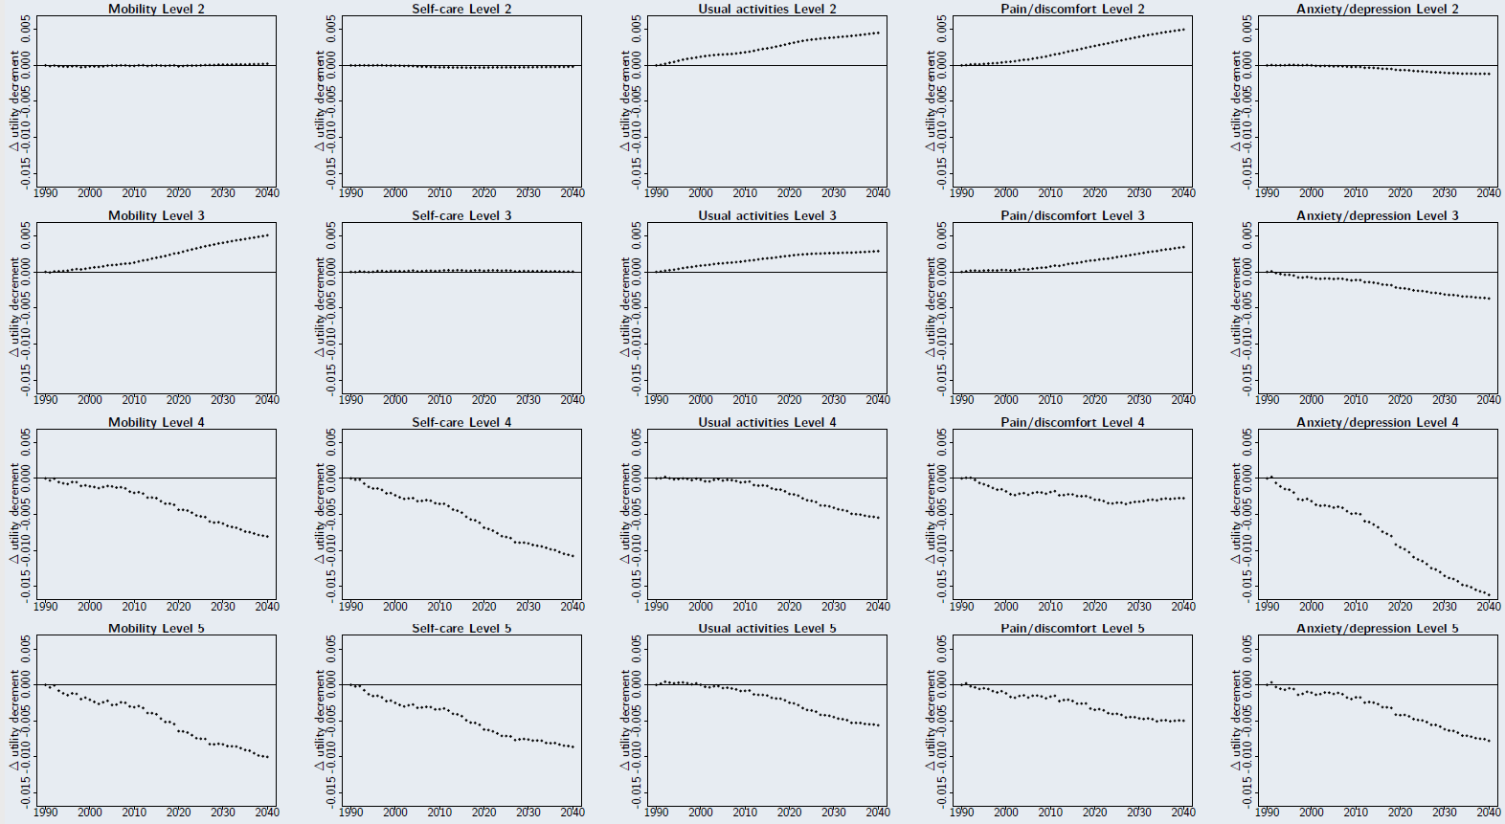
Tracking the evolution of EQ-5D values due to demographic change over a 50-year period
Edward JD Webb¹ Paul Kind^{1,2}
¹University of Leeds ²University College London
Why might population values change?
Measurement technology
Different instruments, e.g. 5L instead of 3L
Composite TTO instead of TTO
Changes in beliefs/attitudes
Different social norms
Spirituality - changing attitudes towards dying
New health technologies - different expectations about length/quality of life
Demographics
Ageing society
Changing ethnic makeup, changing social roles
OR
OR
Our focus
Disentangle impact of demographics from other causes
E.g. do values change because of an aging society
General approach
Estimate dependence of values on demographic characteristics using EQ-5D valuation exercise
Re-weight values to match society at different time points using external data
Case study: Office for National Statistics data 1990-2040
Values re-weighted to match UK population by age/gender
Discussion
Values largely stable, even over long periods
Demographic change alone not a reason to update value sets
Potential indirect effects of demographic change
Future research
Simple and generalizable approach
Could use with other value sets in other contexts
Acknowledgements: EQ-5D-5L valuation data collection was funded by Prostate Cancer UK. The opinions expressed are those of the authors and do not represent the views of Prostate Cancer UK

