Slide 1
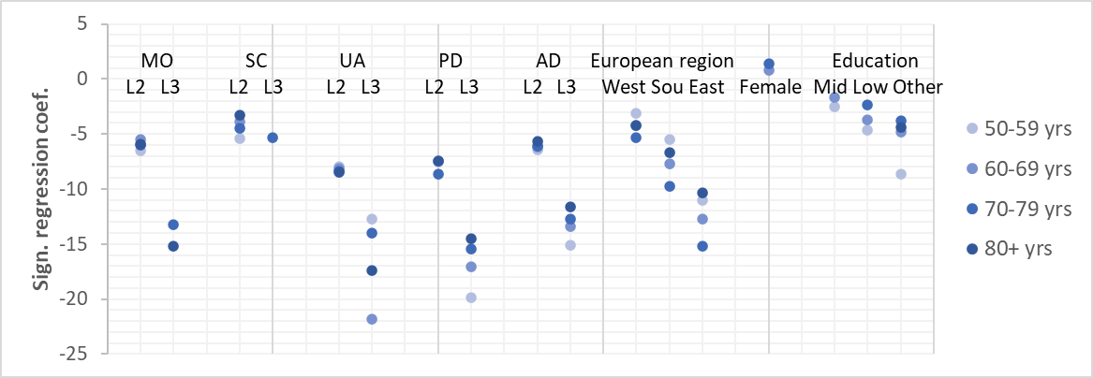
Disentangling the components of the EQ-5D: Which dimensions have an impact on EQ VAS self-ratings in different stages of life?
Ines Buchholz¹ ∙ Mathieu F. (Bas) Janssen²
¹ EuroQol Group ∙ Rotterdam ∙ The Netherlands  inesbuchholz@posteo.de ² Department of Medical Psychology and Psychotherapy Erasmus MC ∙ Rotterdam ∙ The Netherlands  mf.bas.janssen@googlemail.com
OBJECTIVES
To examine the relationship between the 5 dimensions and the EQ VAS and to investigate the impact of each dimension on the respondent’s EQ VAS rating at different stages of life in a large sample of 50+ year old Europeans
METHODS
n=45,706 panelists from the Survey of Health, Ageing, and Retirement in Europe (wave 4)
Regression models for 4 age-groups (50–59, 60-69, 70-79, 80+ year-olds) with EQ VAS (dependent variable), EQ-5D dimensions, gender, European region (15 countries assigned to North, East, South, West Europe), and education (independent variables)
Reference: high educated (ISCED 5 or 6) North European men reporting “no problems”
RESULTS
AD, PD and UA are similar drivers in EQ VAS scores across all age groups; the impact of SC is consistently low.
UA and PD have the highest impact on EQ VAS scores in all ages (Fig. 1).
The influence of both PD and AD is highest in the youngest age group and decreases with increasing age, while the influence of MO increases from the age of 70.
European region is a better EQ VAS score predictor than education and gender, showing a geographical gradient with EQ VAS scores declining continuously from Northern to Western, Southern and Eastern Europe (Fig. 1, Tab. 1).
n Mean EQ VAS (SE) | 50-59 years 15,544 74.8 (0.15) | 60-69 years 17,313 72.5 (0.15) | 70-79 years 11,486 65.9 (0.20) | 80+ years 5,666 57.6 (0.32)
Mobilityª
Some problems walking | -6.50 (1.11)*** | -5.46 (0.71)*** | -6.02 (0.78)*** | -5.94 (1.13)***
Confined to bed | -13.14 (8.43) | -13.12 (7.32) | -13.20 (3.09)*** | -15.19 (4.26)***
Self-careª
Some problems washing or dressing | -5.38 (2.13)** | -3.85 (1.37)** | -4.43 (1.23)*** | -3.28 (1.43)*
Unable to wash or dress | 3.87 (5.41) | -3.00 (3.40) | -5.36 (2.68)* | -3.39 (2.59)
Usual activitiesª
Some problems with usual activities | -8.00 (1.34)*** | -8.09 (0.83)*** | -8.36 (0.94)*** | -8.48 (1.34)***
Unable to perform usual activities | -12.69 (3.61)*** | -21.81 (4.83)*** | -14.02 (2.04)*** | -17.42 (2.37)***
Pain/discomfortª
Moderate pain or discomfort | -7.57 (0.62) *** | -7.42 (0.45)*** | -8.62 (0.62)*** | -7.46 (0.99)***
Extreme pain or discomfort | -19.85 (2.57)*** | -17.08 (1.43)*** | -15.45 (1.49)*** | -14.48 (2.14)***
Anxiety/depressionª
Moderately anxious or depressed | -6.41 (0.68)*** | -6.18 (0.59)*** | -6.12 (0.73)*** | -5.65 (1.11)***
Extremely anxious or depressed | -15.14 (2.63)*** | -13.38 (1.67)*** | -12.73 (1.64)*** | -11.58 (2.46)***
European region (ref: North Europe)
West Europe | -3.10 (0.86)*** | -4.20 (0.46)*** | -5.30 (0.66)*** | -4.20 (1.04)
South Europe | -5.47 (0.95)*** | -7.71 (0.51)*** | -9.74 (0.70)*** | -6.65 (1.14)
East Europe | -11.04 (1.06)*** | -12.69 (0.69)*** | -15.20 (0.97)*** | -10.32 (1.45)
Gender (ref: male)
Female | 0.85 (0.51) | 0.79 (0.40)* | 1.36 (0.55)** | -0.90 (0.94)
Education (ref: high education (ISCED 5 or 6))
Middle education (ISCED 3 or 4) | -2.51 (0.60)*** | -1.70 (0.52)*** | -0.39 (0.96) | -1.67 (1.77)
Low education (ISCED 1 or 2) | -4.61 (0.71)*** | -3.70 (0.55)*** | -2.33 (0.89)** | -1.53 (1.64)
none, still in school, other | -8.63 (1.62)*** | -4.83 (1.09)*** | -3.82 (1.18)*** | -4.37 (1.85)*
Cons. | 89.49 (0.87)*** | 88.80 (0.52)*** | 86.82 (0.87)*** | 84.19 (1.60)***
N | 13,057 | 14,697 | 9,470 | 4,332
R² | 0.387 | 0.4094 | 0.4558 | 0.4369
TABLE 1 Regression results. Models predicting EQ VAS scores. Adjusted R² whole model: 0.435. Data belonging to Fig. 1.
Unstandardized beta-coefficients; robust standard errors (SE) in parentheses; ªreference (ref.): no problems, p-value *** p<0.001 ** p<0.05 * p<0.01
West Europe: Austria, Belgium, France, the Netherlands, Germany, Switzerland; South Europe: Italy, Spain, Slovenia, Portugal, East Europe: the Czech Republic, Hungary, Poland, North Europe: Denmark, Sweden.
ISCED International Standard Classification of Education
MO mobility, SC self-care, UA usual activities, PD pain/discomfort, AD anxiety/depression, Sou south, Mid middle. L2 level 2, L3 level 3, yrs years.
FIGURE 1 Significant correlation coefficients of four regressions models (Tab. 1) by three 10-year age strata and an open-ended age band.
CONCLUSION
In all age models, four of five EQ-5D dimensions substantially contributed to the prediction of EQ VAS scores. However, EQ-5D dimensions impact EQ VAS scores differently across age groups. This could be caused by different dimensions of health making a smaller or larger impact on overall health (as assessed by EQ VAS) with increasing age, but also by different degrees of response shift and age comparative responding of EQ-5D dimensions and EQ VAS. Since the predictive value of the European region was of greater importance than that of other sociodemographic variables, additional determinants of the respective country should be considered when analyzing the EQ VAS across populations.

