Slide 1
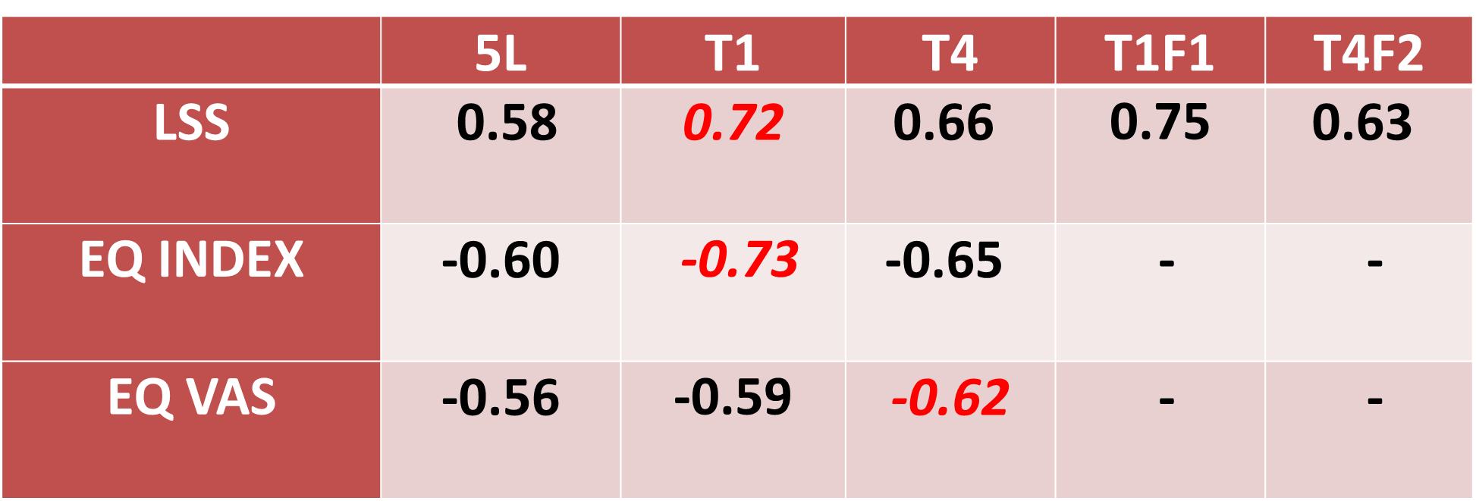
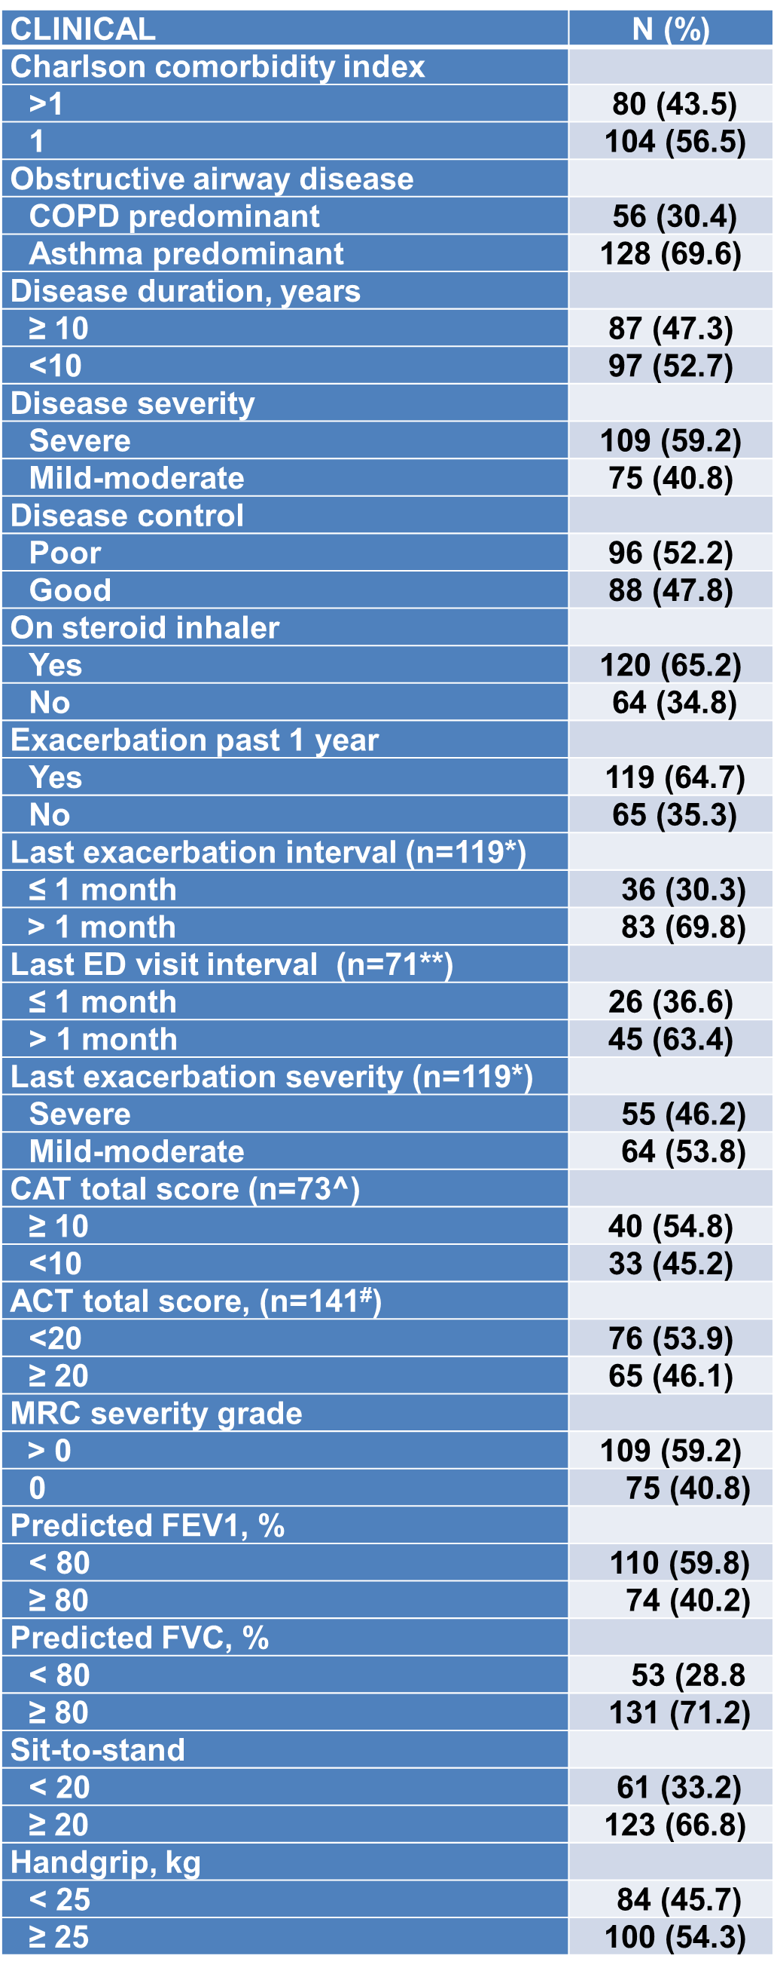
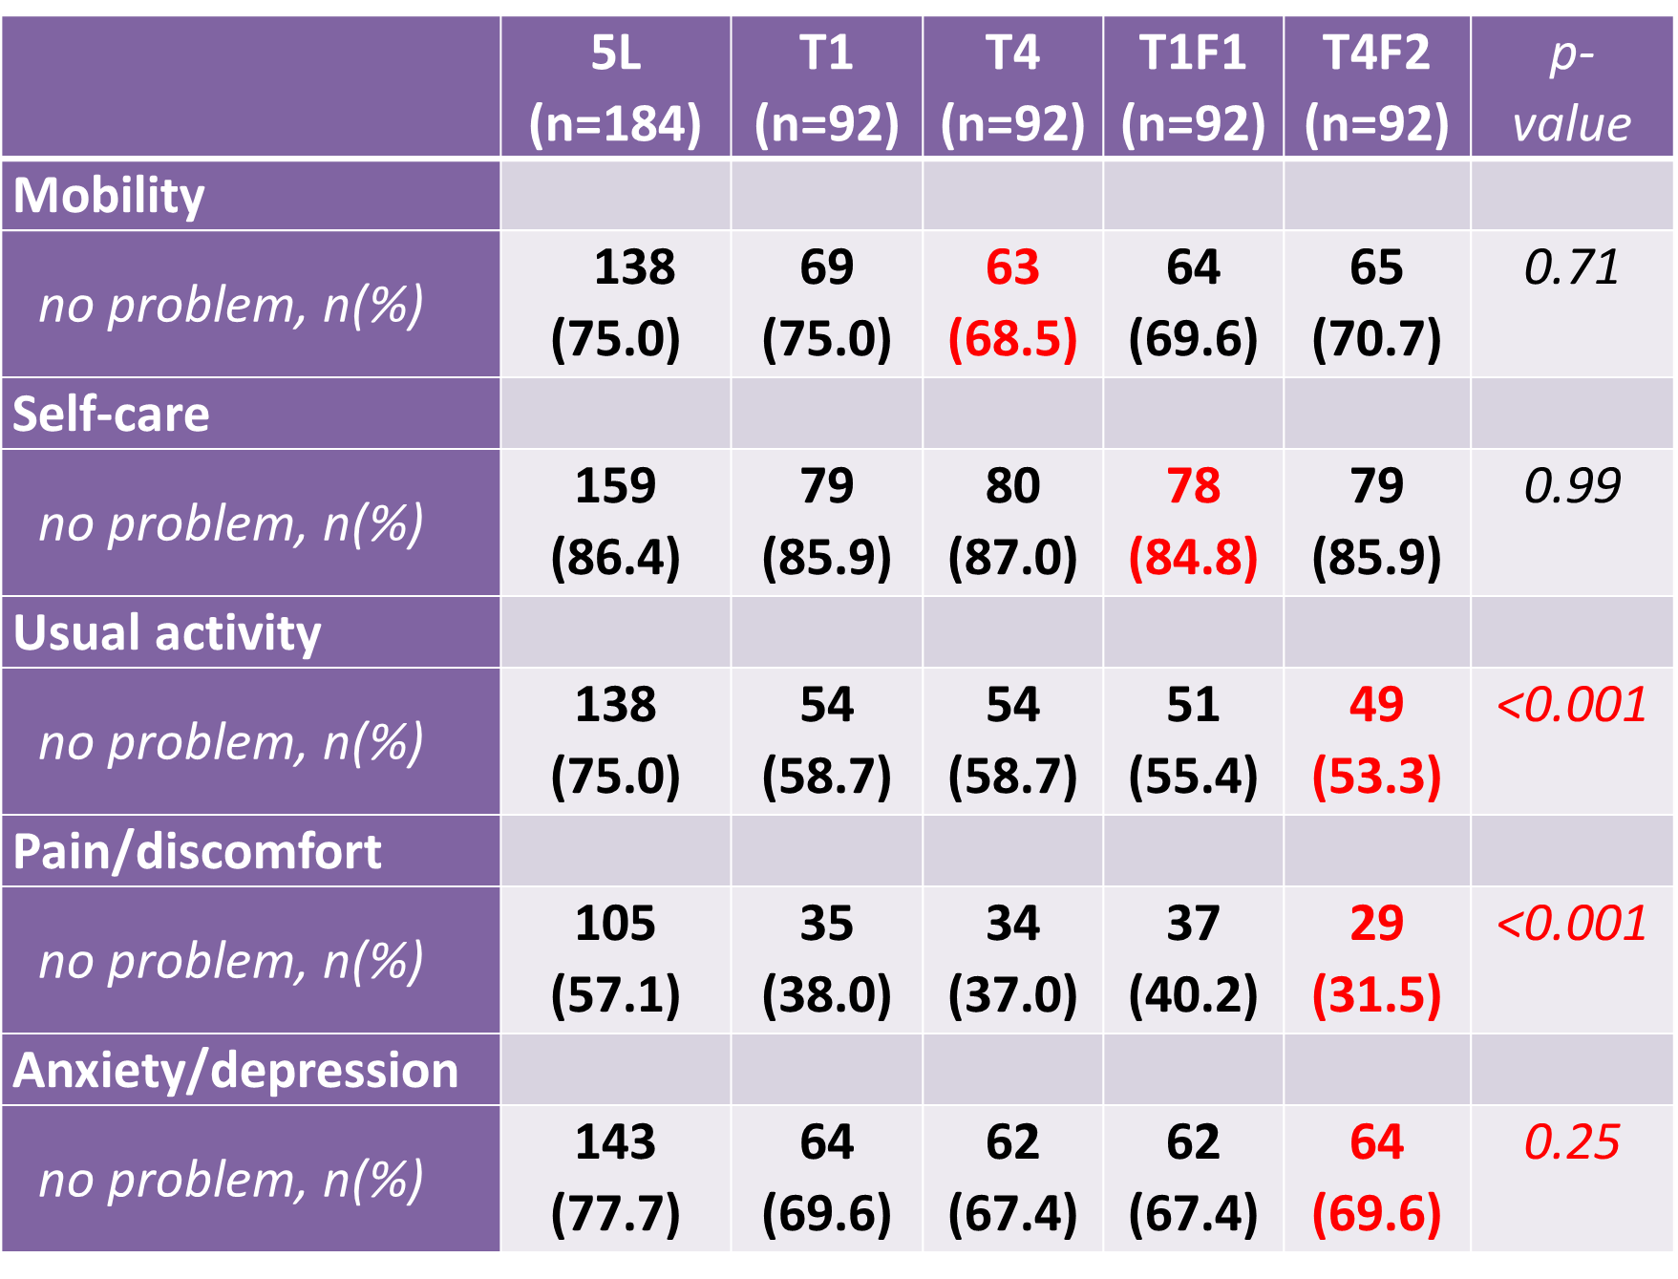
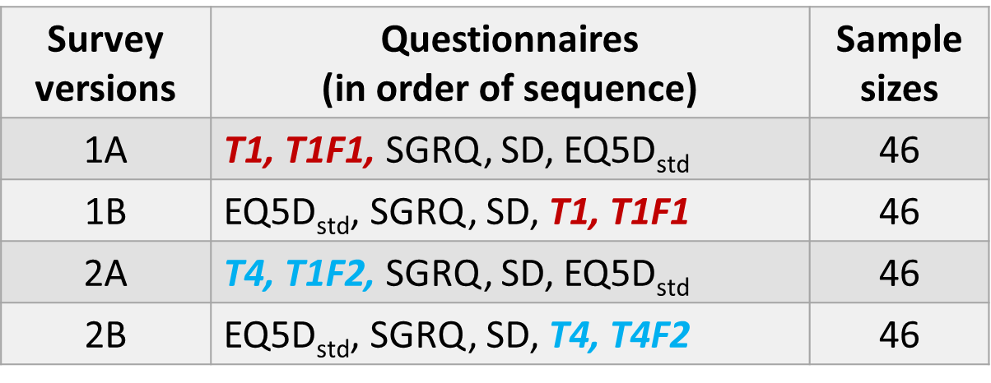
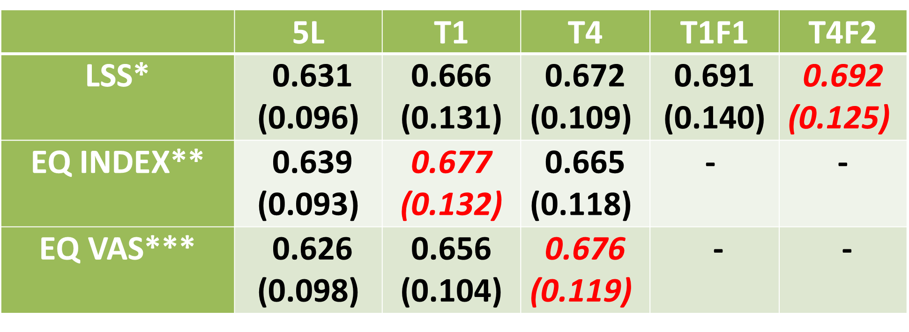
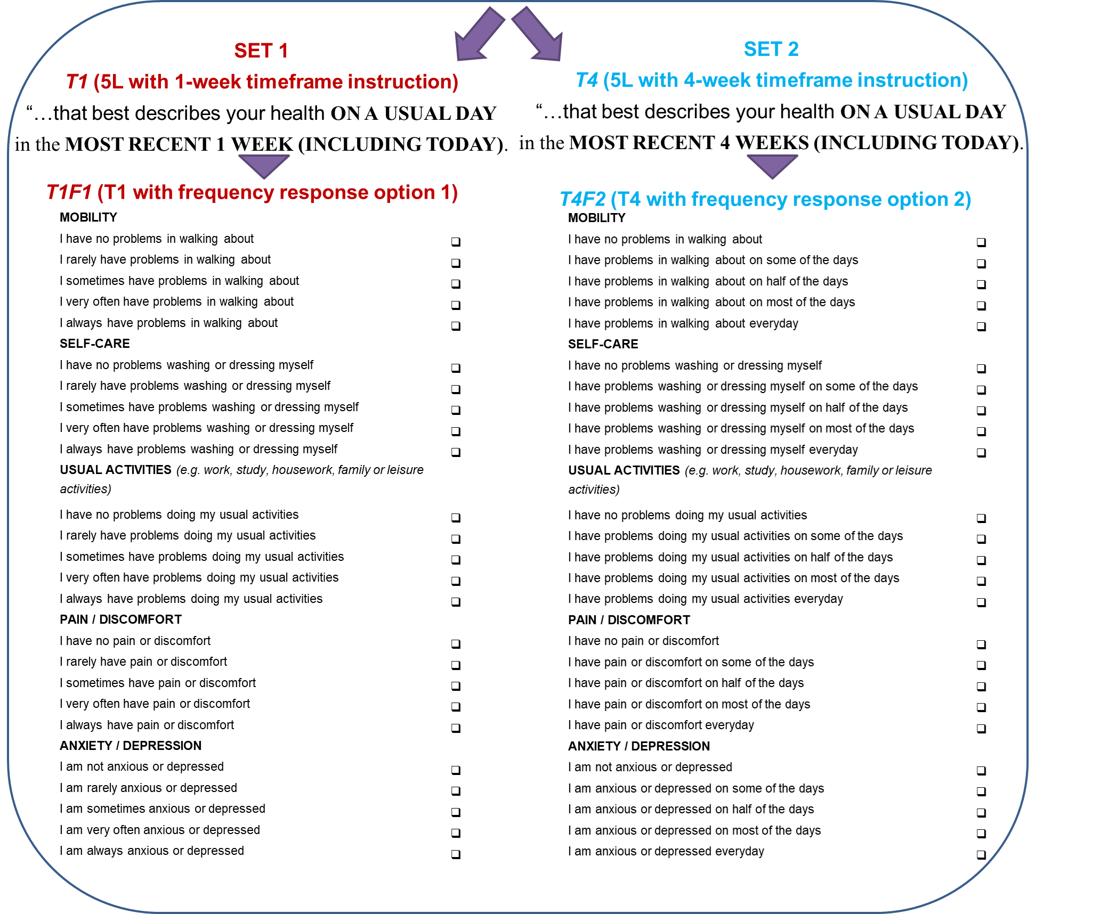
An Exploratory Study of Alternative Timeframes and Frequency-Based Descriptors for EQ-5D-5L in Obstructive Airway Diseases: An Analysis of 184 Patients.
Ai Ping CHUA¹; Bas JANSSEN³; Ling Jie CHENG²; Sonia SOH²; Le Ann CHEN²; Mei Xia LIAO²; N NALUSAMY², Jan BUSSCHBACH⁴; Nan LUO²
¹Department of Medicine, JurongHealth Campus, National University Health System.²Saw Swee Hock School of Public Health, National University Health System.
³EuroQol Research Foundation, Rotterdam, The Netherlands.⁴Erasmus Medical Center, Rotterdam, The Netherlands.
BACKGROUND
EQ-5D-5L with its timeframe of “today” and severity-based response options may limit its ability to capture the effects on patients’ health status of episodic symptoms and exacerbations, which are common manifestations of chronic obstructive airway diseases (OAD)¹⁻⁴.
RESULTS
184 patients [mean(SD) age: 54(18); female: 37.0%; Chinese: 53.3%, Malay: 25.5%, Indians: 15.8%; married: 65.8%; actively employed: 57.6%; residing in public housing: 91.3%; received formal education: 91.3%] were recruited. 17 clinical characteristics used in the C-statistics analyses are presented in table 2.
Correlations with SGRQ total scores were highest in T1 for LSS & EQ index, and in T4 for EQ VAS (Table 3).
Table 3: *Correlations between SGRQ & EQ measures.
AIM
We examined if longer timeframes (“1 WEEK” & “4 WEEKS”) with both severity-based (original) or frequency-based response options can improve the psychometric properties of EQ-5D-5L.
Table 2: Clinical characteristics of the sample.
Proportions reporting “11111” were 46.7% in 5L, 26.1% in T1, 31.5% in T4, 30.4% in T1F1, and 23.9% in T4F2 (p<0.001). Table 3 shows the percentage of “no problems” in individual dimensions in 5L & the 4 variants.
METHODS
Consenting consecutive patients ≥ 21 years old with physician-diagnosed asthma &/or chronic obstructive pulmonary disease (COPD) attending an ambulatory airway clinic were randomized in blocks of four to receive 1 of the four survey versions comprising of 5 different questionnaires in ordered sequence (Table 1) which they self-administered in English or Mandarin via a secure web platform (REDCap®), with a team member physically present to assist.
Table 2: Response distributions of the five EQ items.
*Spearman correlation analyses, p-value<0.001 for all presented data.
The highest correlations amongst the versions is highlighted in bold red for each EQ measure.
The C-statistic means were consistently highest in one of 5L variants for all 3 EQ measures (Table 4).
Table 1: Survey versions compositions and sample sizes.
Table 4: ^Mean (SD) C-statistics of 17 clinical KG for each EQ measure in 5L & 5L variants.
5L: EuroQoL 5 Dimension-5 levels, EQ-5D-5L;
SD: survey on socio-demographics & disease
characteristics; SGRQ: Saint George Respiratory Questionnaire with 3-month timeframe; T1: 5L variant with
1-week timeframe; T4: 5L variant with 4-week timeframe; T1F1: 5L variant with 1-week timeframe and frequency response option 1; T4F2: 5L variant with 4-week timeframe and frequency response option 2.
Each patient received randomly either set 1 or 2 (each consists of 2 modified 5L variants with similar timeframe & different response options) (Figure 1).
We compared ceiling effects among the 5L versions & correlations of their measures (level sum score [LSS], index & VAS) with SGRQ using Spearman’s rho.
We predicted 17 binary self-reported/clinician-assessed clinical outcomes via C-statistic derived from receiver operating characteristic (ROC) analyses.
The lowest ceiling amongst the versions is highlighted in bold red for each EQ item..
C-statistics derived from receiver operating characteristics analyses
*p=0.111; **p=0.509; ***p=0.18.
The highest mean C-statistic value amongst the versions is highlighted in bold red for each EQ measure.
CONCLUSIONS
Use of a timeframe of 1 or 4 weeks with original or frequency-based response labels significantly lowered the ceiling of EQ-5D-5L in patients with OAD. There was also a non-significant trend towards increasing the instrument’s sensitivity. Test-retest reliability will be assessed, and item-level analyses will be performed.
ACT: Asthma Control Test; CAT: COPD Assessment Test; ED: emergency department; FEV1: forced expiratory volume in 1st second; FVC: forced vital capacity; MRC: Medical Research Council dyspnea scale.
*Include only patients who had exacerbations in past 1 year.
**Include only patients who visited the ED.
^Include only patients with COPD who completed the CAT questionnaire.
#Include only patients with asthma who completed the ACT questionnaire.
References
Herdman M, Gudex C, Lloyd A, Janssen M, Kind P, Parkin D, et al. Development and preliminary testing of the new five-level version of EQ-5D (EQ-5D-5L). Qual Life Res. 2011;20(10):1727-36. Mehdipour A, Beauchamp MK, Wald J, Peters N, Kuspinar A. Measurement properties of preference-based measures for economic evaluation in COPD: a systematic review. Qual Life Res. 2020;29(11):2875-85. Szentes BL, Schultz K, Nowak D, Schuler M, Schwarzkopf L. How does the EQ-5D-5L perform in asthma patients compared with an asthma-specific quality of life questionnaire? BMC Pulm Med. 2020;20(1):168. Sanghera S, Coast J. Measuring Quality-Adjusted Life-Years When Health Fluctuates. Value Health. 2020;23(3):343-50.
Figure 1: EQ-5D-5L variant sets
Funding: EuroQol Research Foundation (EQ Project 69-2020RA). The views are solely the authors’ and may not represent those of the EuroQol Research Foundation.

