Slide 1
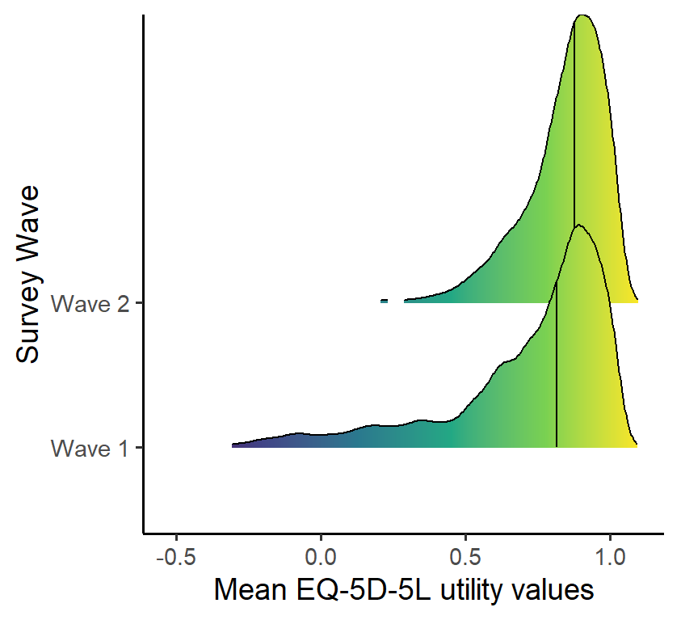
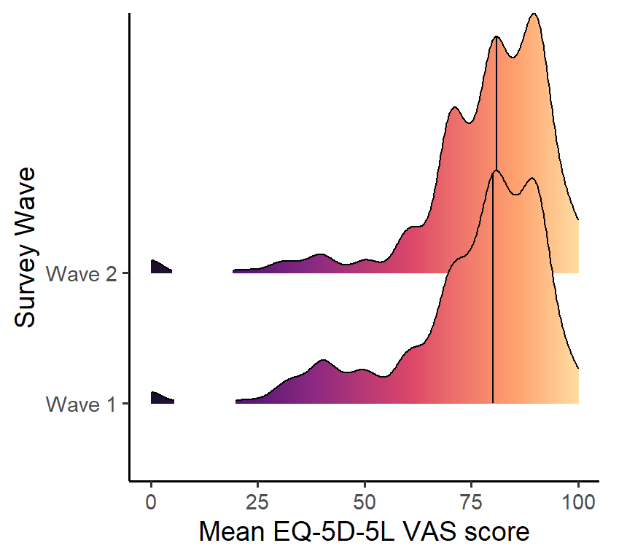
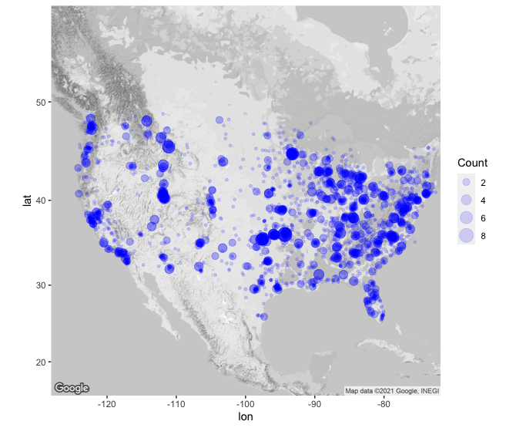
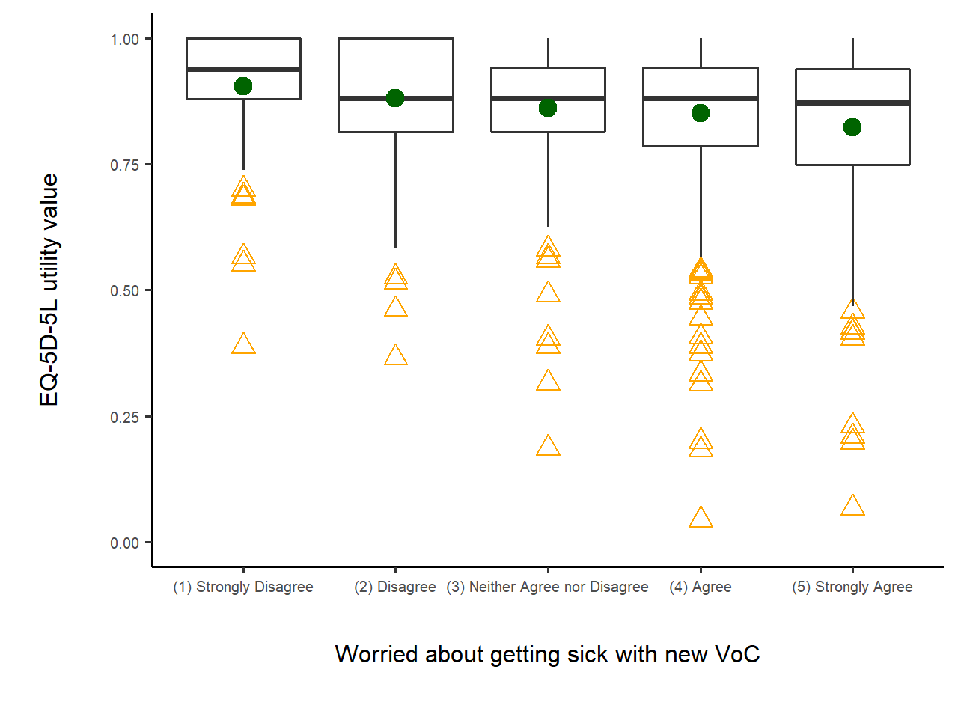
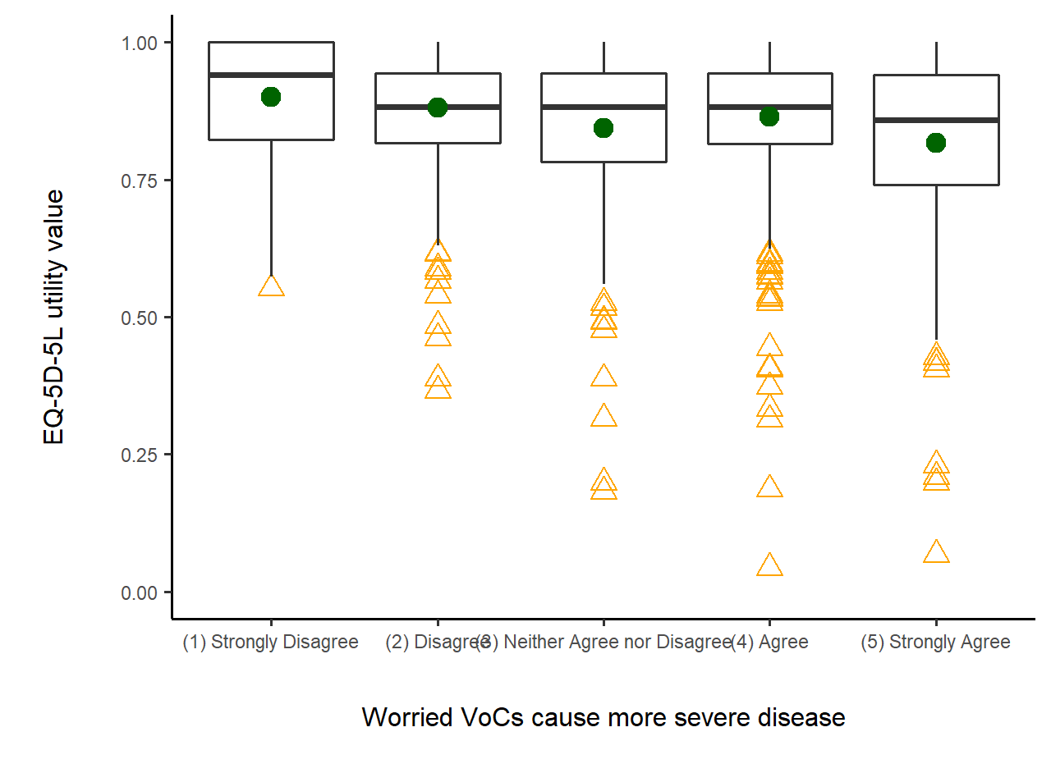
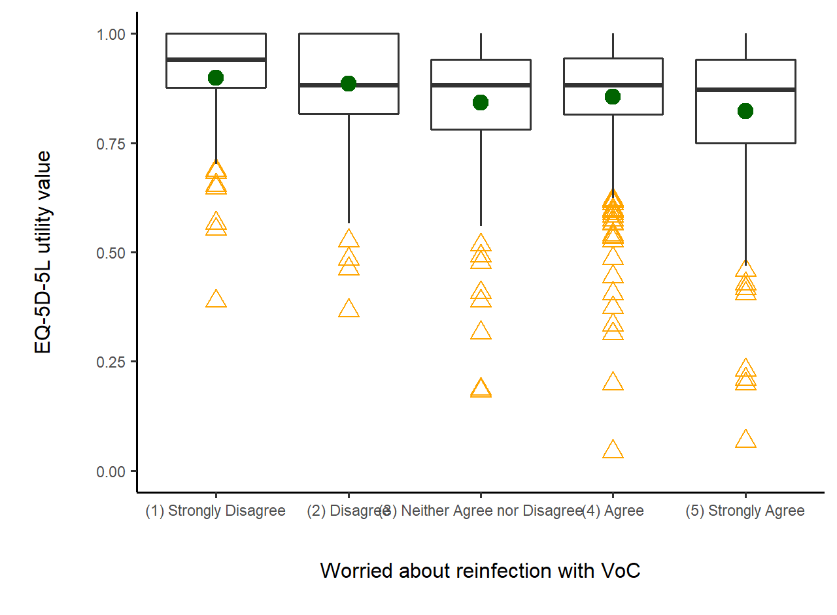
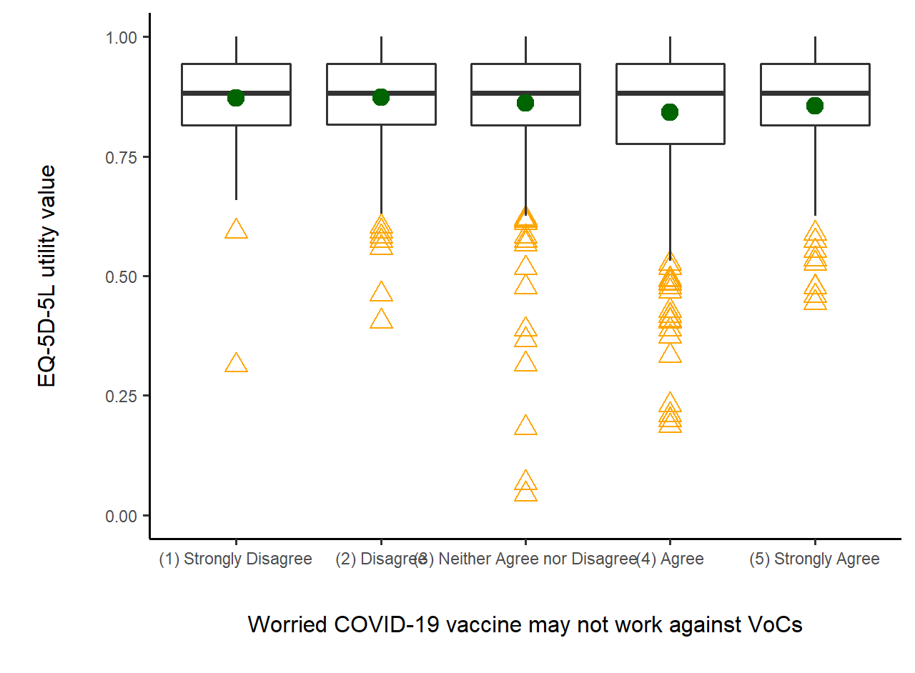
SARS-CoV-2 Variant Concerns Expressed by Pregnant Persons and the Impact on their HRQoL
Annette K Regan,¹ Pallavi Aytha Swathi,^{2,3} Ning Yan Gu¹
¹School of Nursing and Health Professions, University of San Francisco; ² College of Arts & Sciences, University of San Francisco; ³ University of Colorado Anschutz Medical Campus
Objective
Results
Results (Cont’d)
Mar 2020 – Jun 2020: The COVID-19 pandemic impacted the mental and physical health of pregnant and postpartum individuals in the U.S. and internationally.
July 2021 – present: Dominance of variants of concern (VoC) as circulating SARS-CoV-2 could potentially intensify the impact of the COVID-19 pandemic on maternal health.
Figure 2. Distribution of EQ-5D-5L utility values for pre-VoC dominant period (Wave 1) and VoC dominant period (Wave 2).
Figure 3. Distribution of EQ-5D-5L VAS scores for pre-VoC dominant period (Wave 1) and VoC dominant period (Wave 2).
Median EQ-5D-5L utility values were significantly lower during the pre-VoC dominant period compared to the VoC dominant period (0.80 and 0.85 respectively; P=0.001) (Fig 2).
EQ-5D-5L VAS scores were similar across pre-VoC dominant and VoC dominant periods (77.0 and 78.6, respectively; P=0.05) (Fig 3).
Concern that VoCs would cause more severe disease was the most common concern (36% agreed / 29% strongly agreed) (Fig 4).
The least common concern was getting sick with a new VoC (17% agreed / 11% strongly agreed) (Fig 4).
For every 1 unit increase in respondent’s self-reported concern about SARS-CoV-2 variants, the EQ-5D-5L utility value declined by 0.005 units (95% CI -0.038, -0.002) (Fig 5).;
Concern that VoCs would cause more severe illness more commonly were more likely to report problems with anxiety/depression (60% vs. 55%, P=0.04), but not other EQ-5D-5L measures.
m
OBJECTIVE: To measure the HRQoL among mothers prior to and following the emergence of SARS-CoV-2 variants
Methods
Analysis
Wilcoxon rank sum tests to compare HRQoL before and after VoC dominance.
Quantile regression to estimate HRQoL associated with VOC beliefs.
Chi-square tests to compare the distribution of EQ-5D-5L items in relation to SARS-CoV-2 variant concerns.
Study Design: Cross-sectional, national online survey (Fig 1)
Participants: Pregnant and postpartum adults ≥18 years old speaking English or Spanish
Study Period:
Pre-VoC dominant survey period (WAVE 1): May to July 2021 (n=3,392)
VoC dominant survey period (WAVE 2): December 2021 – April 2022 (n=3,268).
Figure 4. Frequency of self-reported concerns about SARS-CoV-2 VoCs among pregnant and postpartum adults
Figure 5. Boxplots summarizing the distribution of EQ-5D-5L utility values by VoC beliefs among pregnant and postpartum individuals
Conclusion
Overall, indicators of HRQoL were higher among pregnancies occurring during the VoC dominant period compared to earlier in the pandemic.
These results may indicate that pregnancy at the start of the pandemic was more likely to adversely influence maternal HRQoL.
Concern about how VoCs could impact health were not uncommon among pregnant and postpartum individuals, especially concerns about severity of disease with VoCs.
Lower HRQoL were observed for mothers who reported strong concerns that VoCs would cause severe disease – and these concerns appeared to be most closely linked with greater anxiety/depression.
These results provide further insight into how the ongoing COVID-19 pandemic may influence the health of pregnant individuals and new parents. Ongoing mental health support to pregnant and postpartum individuals could mitigate adverse health impacts of the pandemic.
Figure 1. Distribution of survey participants
Factor | Scale | Measurements
HRQoL | EQ-5D-5L | 5 item EQ-5D-5L Utility values Visual Analogue Scale (VAS)
COVID-19 VoC Beliefs | Concern on Likert Scale | Worried about getting sick with a new VoC Worried VoCs cause more severe disease Worried about reinfection with a VoC Worried COVID-19 vaccines may not work against VoCs
Acknowledgements:
We would like to acknowledge the time and effort provided by the participants of this study.
Funding: EuroQol 260-RA & 384-RA & USF FDF
Contact information: Dr. Annette Regan
akregan@usfca.edu @AKRegan

