Slide 1


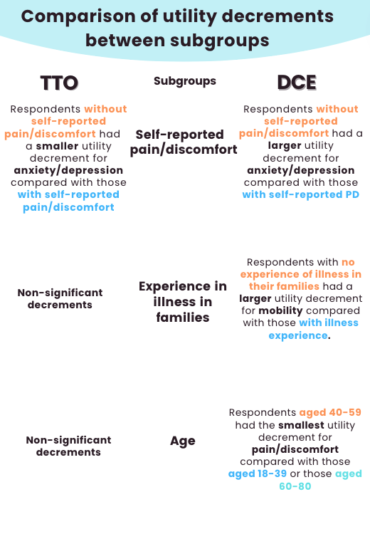
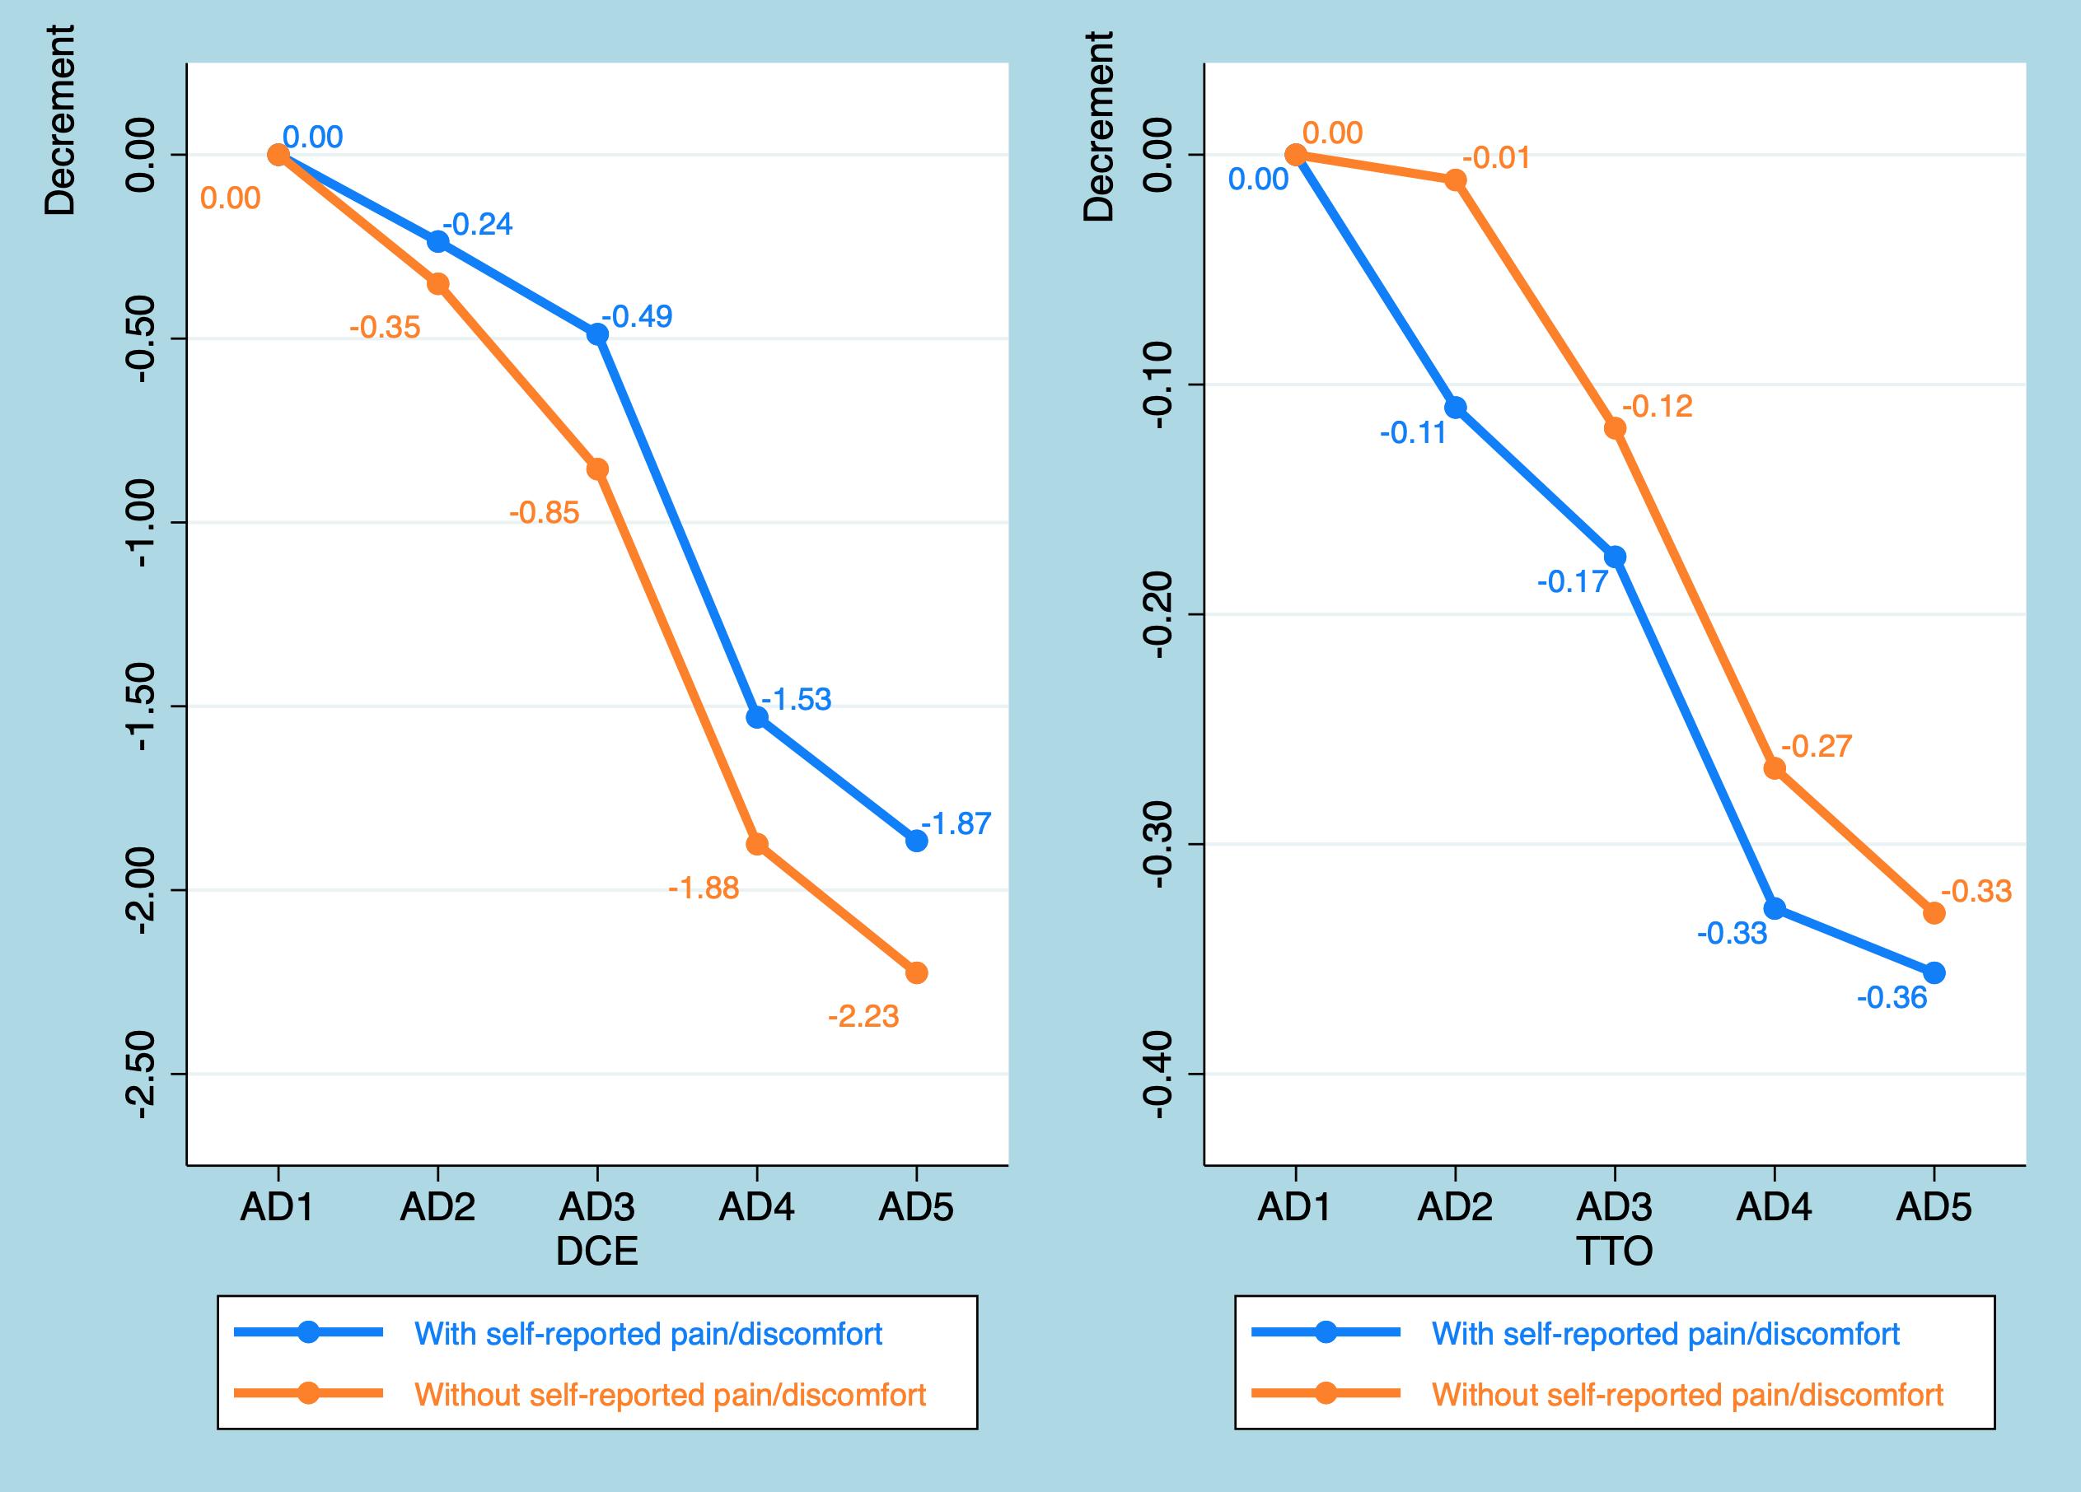
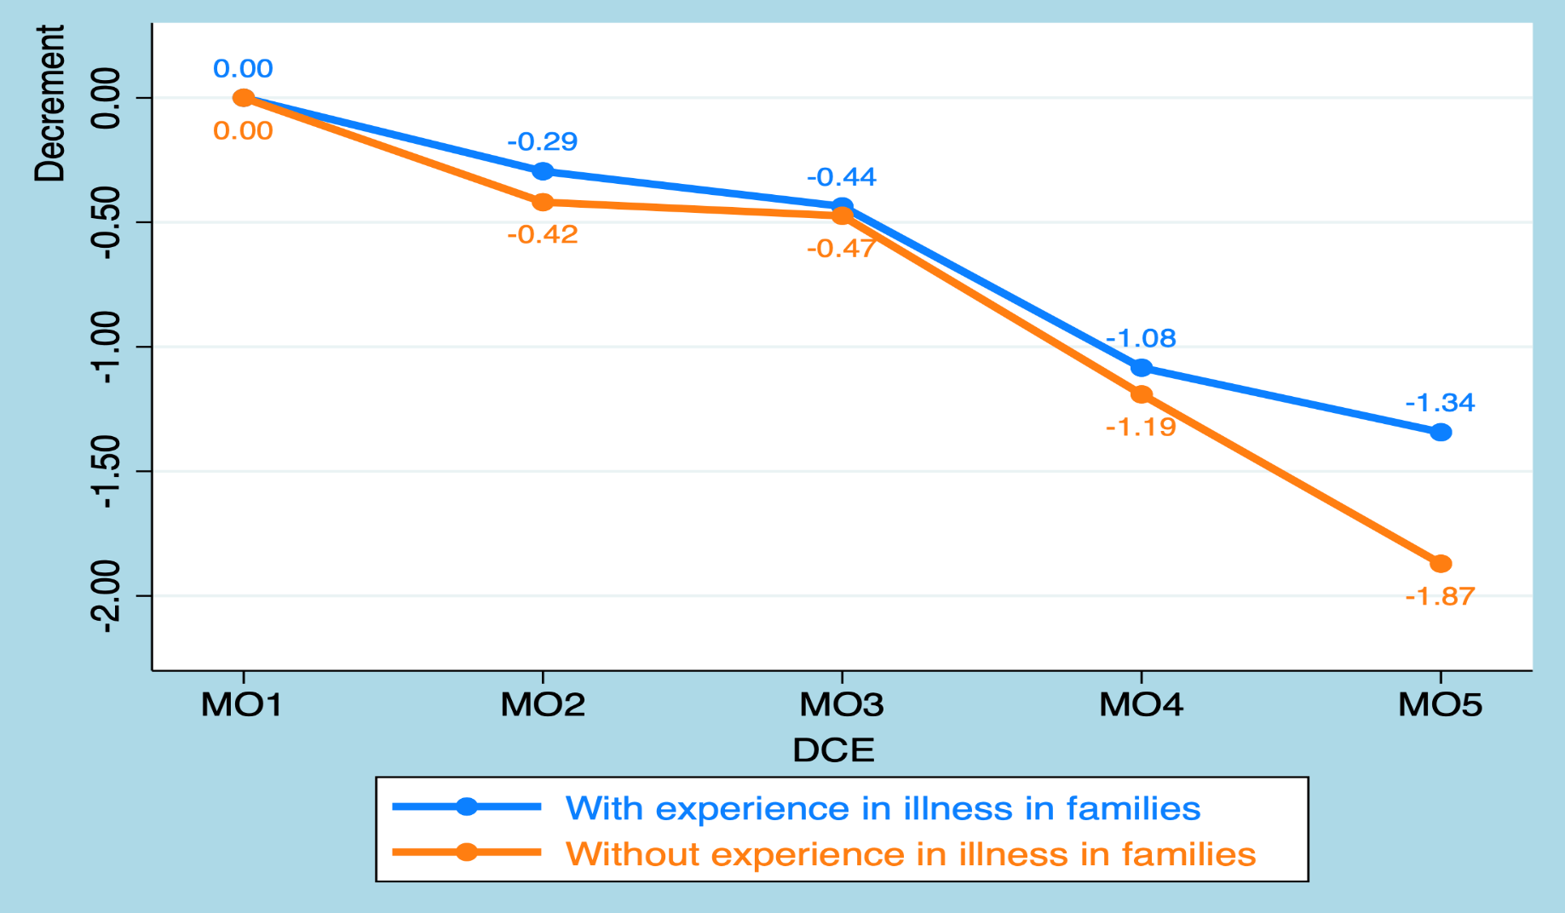
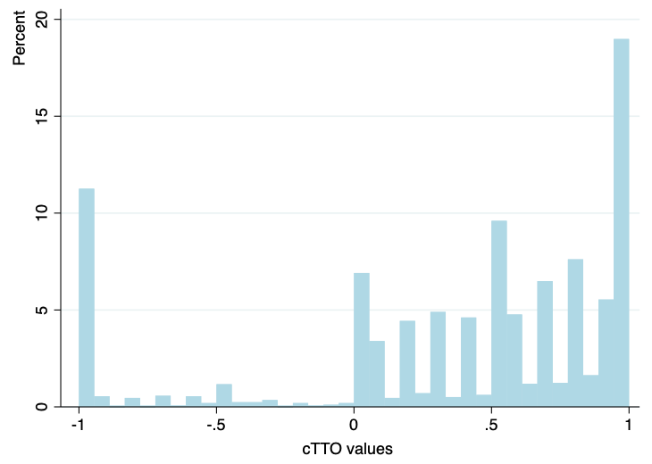
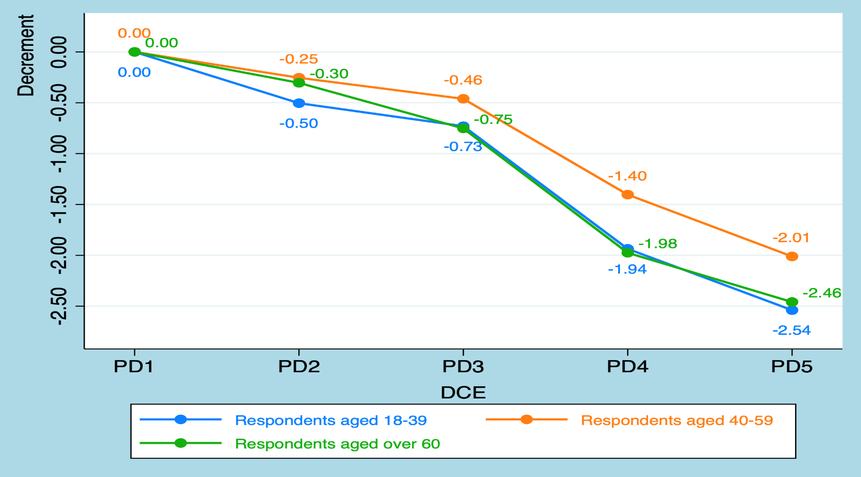
Effect of demographic characteristics on health states valuation
based on TTO and DCE
Yiting Luo¹, Brendan Mulhern¹, Richard Norman², Deborah Street¹, Rosalie Viney¹
¹ Centre for Health Economics Research and Evaluation (CHERE), University of Technology Sydney, ² Curtin School of Population Health, Curtin university
Objectives
RESULTS
This study aimed to explore whether different demographic characteristics including age, experience of illness, and self-reported health result in different values for EQ-5D-5L health states. We also investigated whether the effects of demographic characteristics were the same across two valuation methods.
Table 2. Characteristics of respondents
Characteristics | EQ-VT sample (N=302)
 | Frequency | %
Gender
Female | 148 | 49.01
Male | 154 | 50.99
Age groups(years)
18-39 | 90 | 29.8
40-59 | 106 | 35.1
60+ | 106 | 35.1
Experience in illness*
In families | 230 | 76.16
In others | 120 | 39.74
In self | 103 | 34.11
Problems in EQ-5D-5L self-reported health outcomes*
Mobility | 54 | 17.88
Self-care | 7 | 2.32
Usual activities | 60 | 19.87
Pain/discomfort | 154 | 50.99
Anxiety/depression | 107 | 35.43
METHODS
In total, 302 respondents completed an adapted EQ-VT protocol that included 15 TTO tasks and 14 DCE tasks.
Utility decrements for the five levels of the five dimensions in EQ-5D-5L were estimated across age groups, and across five dichotomized subgroups based on self-reported health and health experience(Table 1). Descriptive statistics were generated.
Conditional logit models were used to derive utility decrements in DCE data and Tobit models with data censored at -1 were used to derive utility decrements in TTO data.
Figure 2. Decrement charts for respondents with or without pain/discomfort
Table 1. Demographics characteristics of interest
* Multiple characteristics may apply to one respondent
Demographics characteristics | Subgroups
Age | 18-39 vs. 40-59 vs. 60+
Experience in illness in families | No vs. Yes
Experience in illness in others | No vs. Yes
Experience in illness in self | No vs. Yes
EQ-5D self-reported anxiety/depression | No vs. Any problems
EQ-5D self-reported pain/discomfort | No vs. Any problems
Figure 3. Decrement chart for respondents with or without experience
in illness in families
Figure 1. The distribution of observed cTTO values
Figure 4. Decrement chart for respondents in different age groups
CONCLUSIONS
The patterns found in the models based on the DCE data were not consistent with those found in the models based on the TTO data. This suggests differences in preference patterns based on the elicitation procedure used. Further exploratory analyses to investigate the sources of the differences would support the further development and appropriate use of these elicitation procedures.
Acknowledgments
The data collection was funded by NHMRC and EuroQol Research Foundation.

