Slide 1
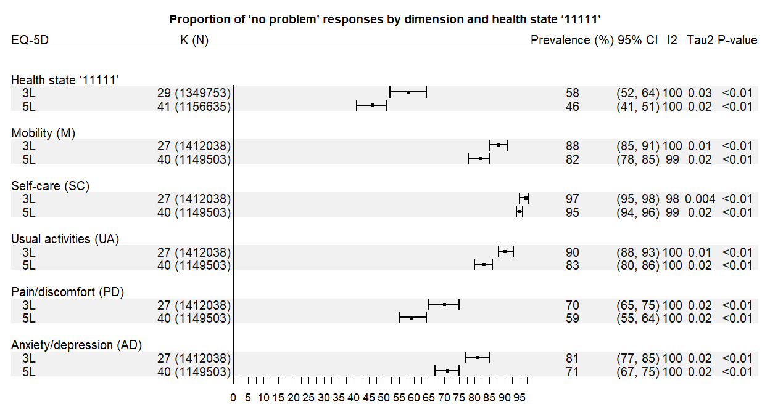
The Ceiling Effects of EQ-5D in General Population Health Surveys:
A Systematic Review and Meta-analysis
Ling Jie CHENG¹, Tianxin PAN², Brendan MULHERN³, Nancy DEVLIN², Nan LUO¹
¹ Saw Swee Hock School of Public Health, National University of Singapore, Singapore, Singapore
² Health Economics Unit, University of Melbourne, Melbourne, Australia
³ Centre for Health Economics Research and Evaluation, University of Technology Sydney, Sydney, Australia
BACKGROUND
‘Ceiling effects’ were defined as the proportion of individuals who reported ‘no problems’. Both the EQ-5D-3L and 5L have higher ceiling effects than other generic measures of health-related quality of life. These ceiling effects are especially high when EQ-5D is used in general population surveys. High ceiling effects mean EQ-5D may be insensitive to changes or differences in individuals with relatively mild health problems. A wide range of EQ-5D ceiling effects have been observed across countries. The reasons for these variations are not well understood.
RESULTS
Of the 15,829 initially identified records, 58 articles collecting data from 2,657,112 adults from 32 countries were included. Most studies were conducted in Europe (41%) and East/Southeast Asia (41%). Most (k = 50, 86.2%) employed probability sampling and were performed as a household survey. More than half of the EQ-5Ds were administered by an interviewer (k = 30, 51.7%) using non-English version (k = 39, 67.2%).
The proportion of '11111' decreased from 58% (95% Confidence Interval (CI) 52, 64%) in 3L to 46% (95% CI 41, 51%) in 5L, indicating an absolute reduction of 11.8% and a relative reduction of 20.5% (Figure 1).
SC showed the highest ceiling effect (3L: 97%; 5L: 95%), and PD the lowest (3L: 70%; 5L: 59%).
PD showed the largest reduction, with the absolute and relative reductions being 10.8% and 15.4%, respectively.
The ceiling effect in East/South-East Asia was higher than in Europe by 26% (95%CI 17-34%) in 3L and 13% (95%CI 2-24%) in 5L. However, the difference became statistically insignificant for 5L after adjusting for age (Table 1).
At the item level, the ceiling effects of all 3L and 5L dimensions are consistently higher in East/South-East Asia than in Europe. The difference in SC (3L) and MO and SC (5L) remained significant after adjustment for age and survey design.
AIM
To investigate the magnitude and variations in EQ-5D ceiling effects at both profile and item levels in general population health surveys.
METHODS
Eight databases (PubMed, Cochrane Library, EMBASE, CINAHL, Web of Science, PsycINFO, ProQuest, Scopus) were searched for observational studies published in English between inception and January 19, 2022. Ceiling effects were calculated by dividing the number of participants reporting full health at dimension or profile level by the total sample size. Meta-analysis was conducted using the metafor package in R software and analyses were repeated for each of the EQ-5D dimensions.
Figure 1: Proportion of ‘no problem’ responses by dimension and ‘11111’.
Table 1. Meta-regression analysis of ceiling effects (‘11111’) of 3L and 5L
Covariates | 3L |  |  |  |  |  | 5L
 | k | β | SE | 95% CI | p-value |  | k | β | SE | 95% CI | p-value
Mean age | 23 | -0.003 | 0.006 | -0.02, 0.01 | 0.65 |  | 27 | -0.01 | 0.004 | -0.02, -0.002 | 0.02*
Proportion of male | 28 | 0.002 | 0.006 | -0.01, 0.01 | 0.75 |  | 41 | 0.003 | 0.007 | -0.01, 0.02 | 0.68
Region (Ref: European) | 29 |  |  |  |  |  | 41
America (North, Central, South) |  | -0.02 | 0.05 | -0.14, 0.08 | 0.62 |  |  | 0.08 | 0.06 | -0.04, 0.19 | 0.18
Asia (East, South-East) |  | 0.26 | 0.04 | 0.17, 0.34 | <0.001*** |  |  | 0.13 | 0.05 | 0.02, 0.24 | 0.02*
Western Pacific (Australia, New Zealand) |  |  |  |  |  |  |  | -0.10 | 0.10 | -0.31, 0.11 | 0.36
Note. k = number of studies; β = Coefficient; SE = Standard error; CI = Confidence interval; *p<0.05; **p<0.01; ***p<0.001
CONCLUSIONS
This systematic review may inform future research into the ceiling effects of EQ-5D and methods for mitigating this problem. Ceiling effects in Asia are higher than other regions and are not fully explained by demographic differences, suggesting that culture-specific interpretations or response patterns may exist. The smaller ceiling effects and difference in the ceiling effects across regions suggests that 5L is superior to 3L for use in general population health surveys.
Funding: EuroQol Research Foundation – EQ-402-RA. Views expressed are those of the authors and are not necessarily those of the EuroQol Research Foundation

