Slide 1
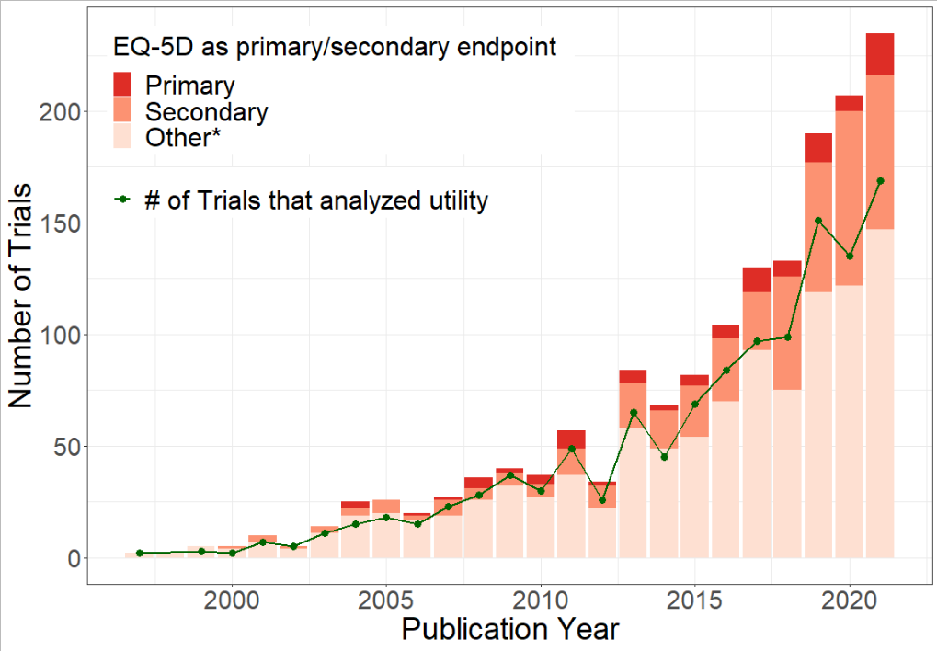
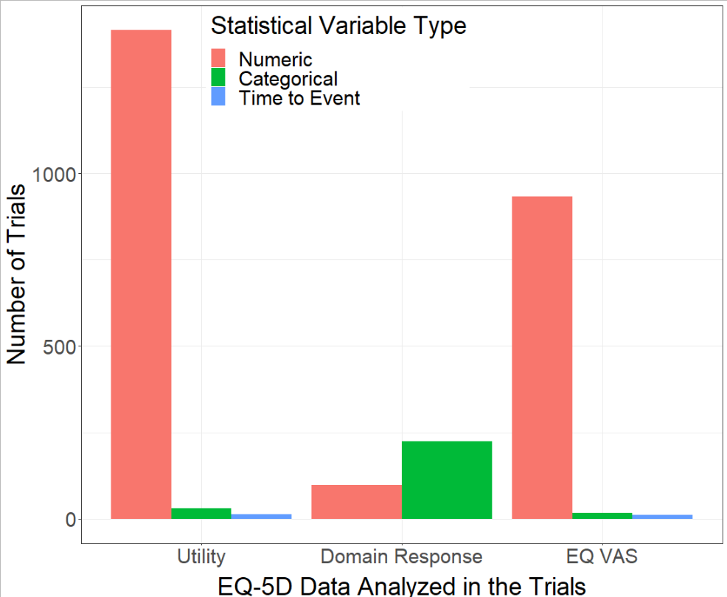
A systematic literature review on statistical methods applied to analyse EQ-5D data in randomized clinical trials
e
Jiajun Yan¹, Ruinan Xie¹, Ziran Yin¹, Preston Tse¹, Meixuan Li¹, Sha Diao², Zhenyan Bo², Jing Cai¹, Shitong Xie¹, Shun Fu Lee¹, Eleanor Pullenayegum^{3, 4}, Feng Xie¹
¹ Department of Health Research Methods, Evidence & Impact, McMaster University, Hamilton, Canada, ² Department of Pharmacy/Evidence-based Pharmacy Center, West China Second University Hospital, Sichuan University, Sichuan, China
³ The Hospital for Sick Children, Toronto, Ontario, Canada; ⁴ Dalla Lana School of Public Health, The University of Toronto, Toronto, Canada
Objective
To systematically summarize statistical methods that have been used to compare treatment effect using EQ-5D data in randomized clinical trials (RCTs).
Results
Table 2. Summary of Statistical Methods for Numeric Utility
Fig 1. PRISMA diagram
Fig 2. Number of Trials analyzed EQ-5D from 1997-2021
Category/Methods | n(%) Total | Proportion
Trials that analysed numeric EQ-5D | 1416
Unadjusted Methods | 608
T-test | 363(59.70%)
Mann-Whitney U Test | 126(20.72%)
Wilcoxon Test | 68(11.18%)
ANOVA | 41(6.74%)
Bootstrap | 23(3.78%)
Kruskal-Wallis Test | 9(1.48%)
Other | 79(12.99%)
Adjusted Methods | 405
ANCOVA | 156(38.52%)
Linear Regression | 96(23.7%)
Linear Mixed Regression | 89(21.98%)
Generalized Linear Regression | 13(3.21%)
Logistic Regression | 4(0.99%)
Other | 35(8.64%)
Not Specified | 20(4.94%)
Repeated Measure Methods | 183
MMRM | 119(65.03%)
Repeated ANOVA | 29(15.85%)
GEE | 25(13.66%)
Repeated ANCOVA | 4(2.19%)
Other | 6(3.28%)
Simple Descriptive Comparison | 383
Records identified through
database search
n = 5536
Method
EMBASE and MEDLINE were searched in November 2021 to identify RCTs that reported and analysed the EQ-5D data. All articles are screened and reviewed in duplicate by two reviewers.
Inclusion Criteria:
Trials with 2 or more arms where participants were randomized
Trials with at least one post baseline EQ-5D measurements
Trials reported EQ-5D results by treatment groups
Exclusion Criteria:
Only reported EQ-5D derived quality-adjusted life-year
Only analyzed EQ-5D as total population (e.g., predictor studies)
Data Extraction
Data is extracted and validated by two reviewers independently. The following information is extracted: trial characteristics, EQ-5D assessment and response format, and statistical method.
Data Analysis
The following information are summarized:
Trial characteristics and EQ-5D assessments
The reported format of EQ-5D
Statistical methods grouped as unadjusted methods, adjusted methods(factors’ adjustment), and repeated measure methods.
Excluded for duplicate
n = 63
Abstracts screened
n = 5473
Excluded for title and abstract
n = 1901
Full-texts screened
n = 3572
Excluded full texts
n = 1602
Duplicate 649
Study design 322
No results by groups 390
Outcome 167
Other 74
Included publications
n = 1970
（ 1869 RCTs）
* Other refers to unspecified endpoints other than primary and secondary, e.g., PRO, HRQoL endpoints.
Fig 3. Number of RCTs by EQ-5D Data Analysis
1416
Table 1. Trial characteristics and EQ-5D assessment
Trial Characteristics | N (%)
Trial design
Parallel group | 1790 (95.8%)
Crossover | 43 (2.3%)
Factorial | 27 (1.4%)
Not specified | 9 (0.5%)
Number of arms
2 | 1593 (85.2%)
3 | 158 (8.5%)
>=4 | 71 (3.8%)
Not specified | 47 (2.5%)
EQ-5D assessment | N (%)
Baseline: yes | 1651 (88.3%)
Number of post-baseline assessment
1 | 701 (37.5%)
2 | 444 (23.8%)
3 | 310 (16.6%)
4 | 156 (8.4%)
>=5 | 192 (10.3%)
Not specified | 66 (3.5%)
933
* For frequency of methods, multiple application of the same method in a trial will be counted once. For frequency of categories (bold in the table), multiple application of the methods within one category in a trial will be counted once. ; ANOVA = Analysis of Variance; ANCOVA = Analysis of Covariance; MMRM = Mixed Model with Repeated Measure; GEE = Generalized Estimation Equation
Conclusion
Utility is the most frequently analysed for estimating treatment effects in RCTs.
About half of the trials applied unadjusted methods to EQ-5D analysis.
Repeated measure methods have not been commonly used.
‡
225
*
+
97
*
+
30
12
17
11
* Categorized as improved/stable/worsen using a cut-off value, e.g., MCID or population reference
+ Time to improvement/deterioration
‡ Domain scores or sum of scores

