Slide 1



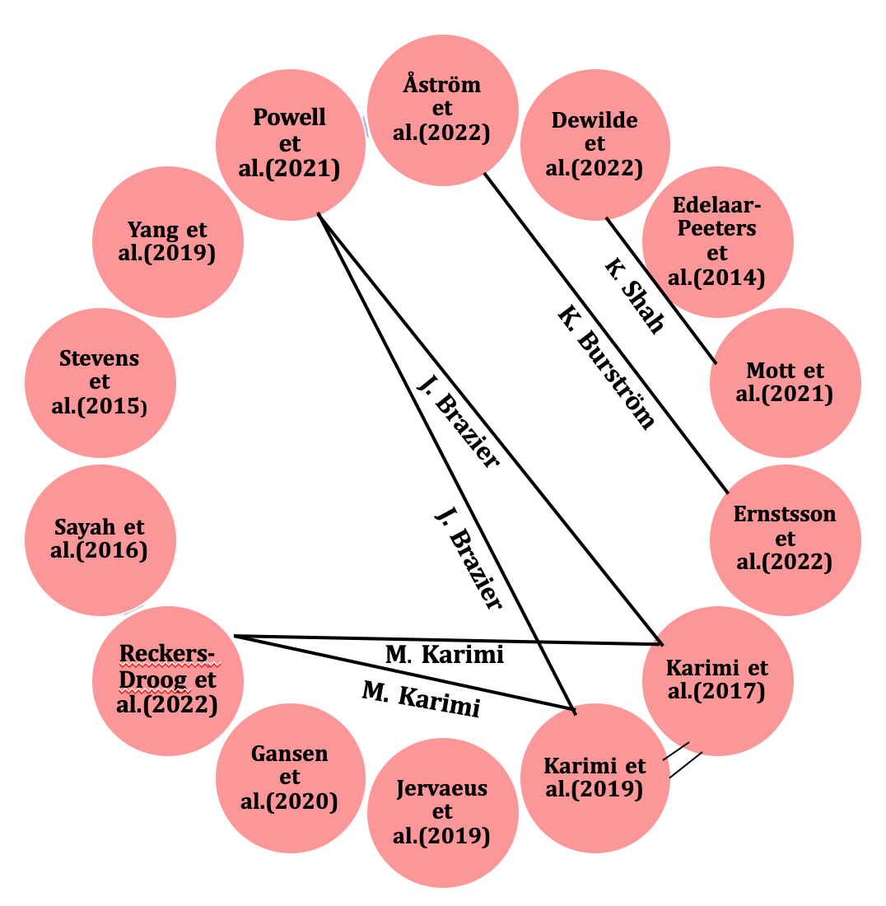
How have qualitative methods been used to understand the
valuation of preference-based measures? A scoping review
Yiting Luo¹, Brendan Mulhern¹, Richard Norman², Deborah Street¹, Rosalie Viney¹
¹ Centre for Health Economics Research and Evaluation (CHERE), University of Technology Sydney, ² Curtin School of Population Health, Curtin university
Objectives
Table 1. Themes and subthemes identified in the qualitative interview
In total, 7 pairs of studies have common authors.
There is no existing review that syntheses how respondents complete preference elicitation tasks used to value generic preference-based measures (GPBMs) of health-related quality of life (HRQoL) to date. This scoping review aimed to summarize the existing qualitative evidence exploring the thought processes of respondents when completing the tasks.
No. | Theme | Subthemes
1 | Personal experience | a. Perception of current life/health
 |  | b. Using own experience and vicarious experience to understand the health states
2 | Health /non-health consequences | a. Impact of the choices on future goal achievement and expectations
 |  | b. Impact of the choices on people close to them
 |  | c. Impact of the choices on autonomy, enjoyment, independence, dignity or happiness
 |  | d. Health consequences such as mental and physical health
3 | Non-health conversion factors | a. Adaptability and strategies for manageability
 |  | b. Availability of resources and support
 |  | c. Hope and meaning in Life
 |  | d. Personal or other people's reaction to ill health
 |  | e. Carers' well-being
 |  | f. Longevity altruism
4 | Difficulties in instruments | a. Struggling with the labels
 |  | b. Difficulties in understanding the implausible combination of dimensions/levels
5 | Difficulties in valuation tasks | a. Difficulties in imagining the hypothetical health states
 |  | b. Difficulties in conceptualizing extreme good health or death
 |  | c. Questions about the stability and realness of the health states
 |  | d. Questions about who should value health states
 |  | e. Assumptions that cannot end lives and changes would not hold in reality
 |  | f. Confusion about LT-TTO tasks and difficulties in distinguishing health states worse than death
METHODS
Search strategy, eligibility criteria, and data extraction
Literatures identified
(n =3569)
Four databases were searched
  Databases included MEDLINE, EMBASE, PsycINFO, and CINAHL
  Search was conducted in early 2022.
Eligibility criteria:
  Studies published between 2015-2022
  Qualitative studies
  Investigating generic preference-based measures(GPBMs)
  Preference elicitation study
Data extraction
  Study characteristics: published year, country
  Sample characteristics: adults or children, sample size, sampling method
  Qualitative data collection and analysis method
  Health states valuation methods
  Aspects of themes identified in the valuation tasks
Literatures after removal of duplicates
(n = 2693)
Figure 5. Network analysis
Table 2. Themes reported in the 14 studies
Author(year) | Themes in the qualitative interview
 | Personal experience | Health /non-health consequences | Non-health conversion factors | Difficulties in instruments | Difficulties in valuation tasks
Åström (2022) | ✓ | ✓ | ✓ | ✓ | ✓
Dewilde (2022) | ✓ | ✓ | ✓ | ✘ | ✓
Edelaar-Peeters (2014) | ✘ | ✘ | ✘ | ✓ | ✓
Ernstsson (2020) | ✓ | ✓ | ✓ | ✓ | ✓
Gansen (2020) | ✓ | ✓ | ✓ | ✘ | ✓
Jervaeus (2019) | ✓ | ✓ | ✓ | ✘ | ✘
Karimi (2017) | ✓ | ✓ | ✓ | ✓ | ✓
Karimi (2019) | ✓ | ✓ | ✓ | ✘ | ✓
Mott (2021) | ✘ | ✓ | ✓ | ✘ | ✘
Powell (2021) | ✓ | ✓ | ✓ | ✓ | ✓
Reckers-Droog (2022) | ✓ | ✓ | ✓ | ✓ | ✓
Sayah (2016) | ✘ | ✓ | ✓ | ✘ | ✓
Stevens (2015) | ✓ | ✘ | ✓ | ✘ | ✓
Yang (2019) | ✘ | ✘ | ✘ | ✓ | ✓
Literatures screened
(n = 2693)
Full-text articles assessed for eligibility
(n =45)
Literatures included in the synthesis
(n=14)
Figure 1. Study flow diagram
RESULTS
Note: ✓ indicates that the specific theme has been reported in the literatures; ✘ indicates the specific theme hasn’t been reported.
CONCLUSIONS
In this review, most of the studies that explore the thought process during valuation focused on adults and assessment for paediatric populations is limited. Therefore, further qualitative research is warranted to investigate the potential challenges in the valuations of paediatric GPBMs.
Figure 2. Year of the publication
Figure 3. Country of the literatures*
Figure 4. Generic preference-based methods*
Acknowledgments
This study is part of Australian Medical Research Future Fund QUOKKA research programme.
* Multiple characteristics may apply to one study

