Slide 1
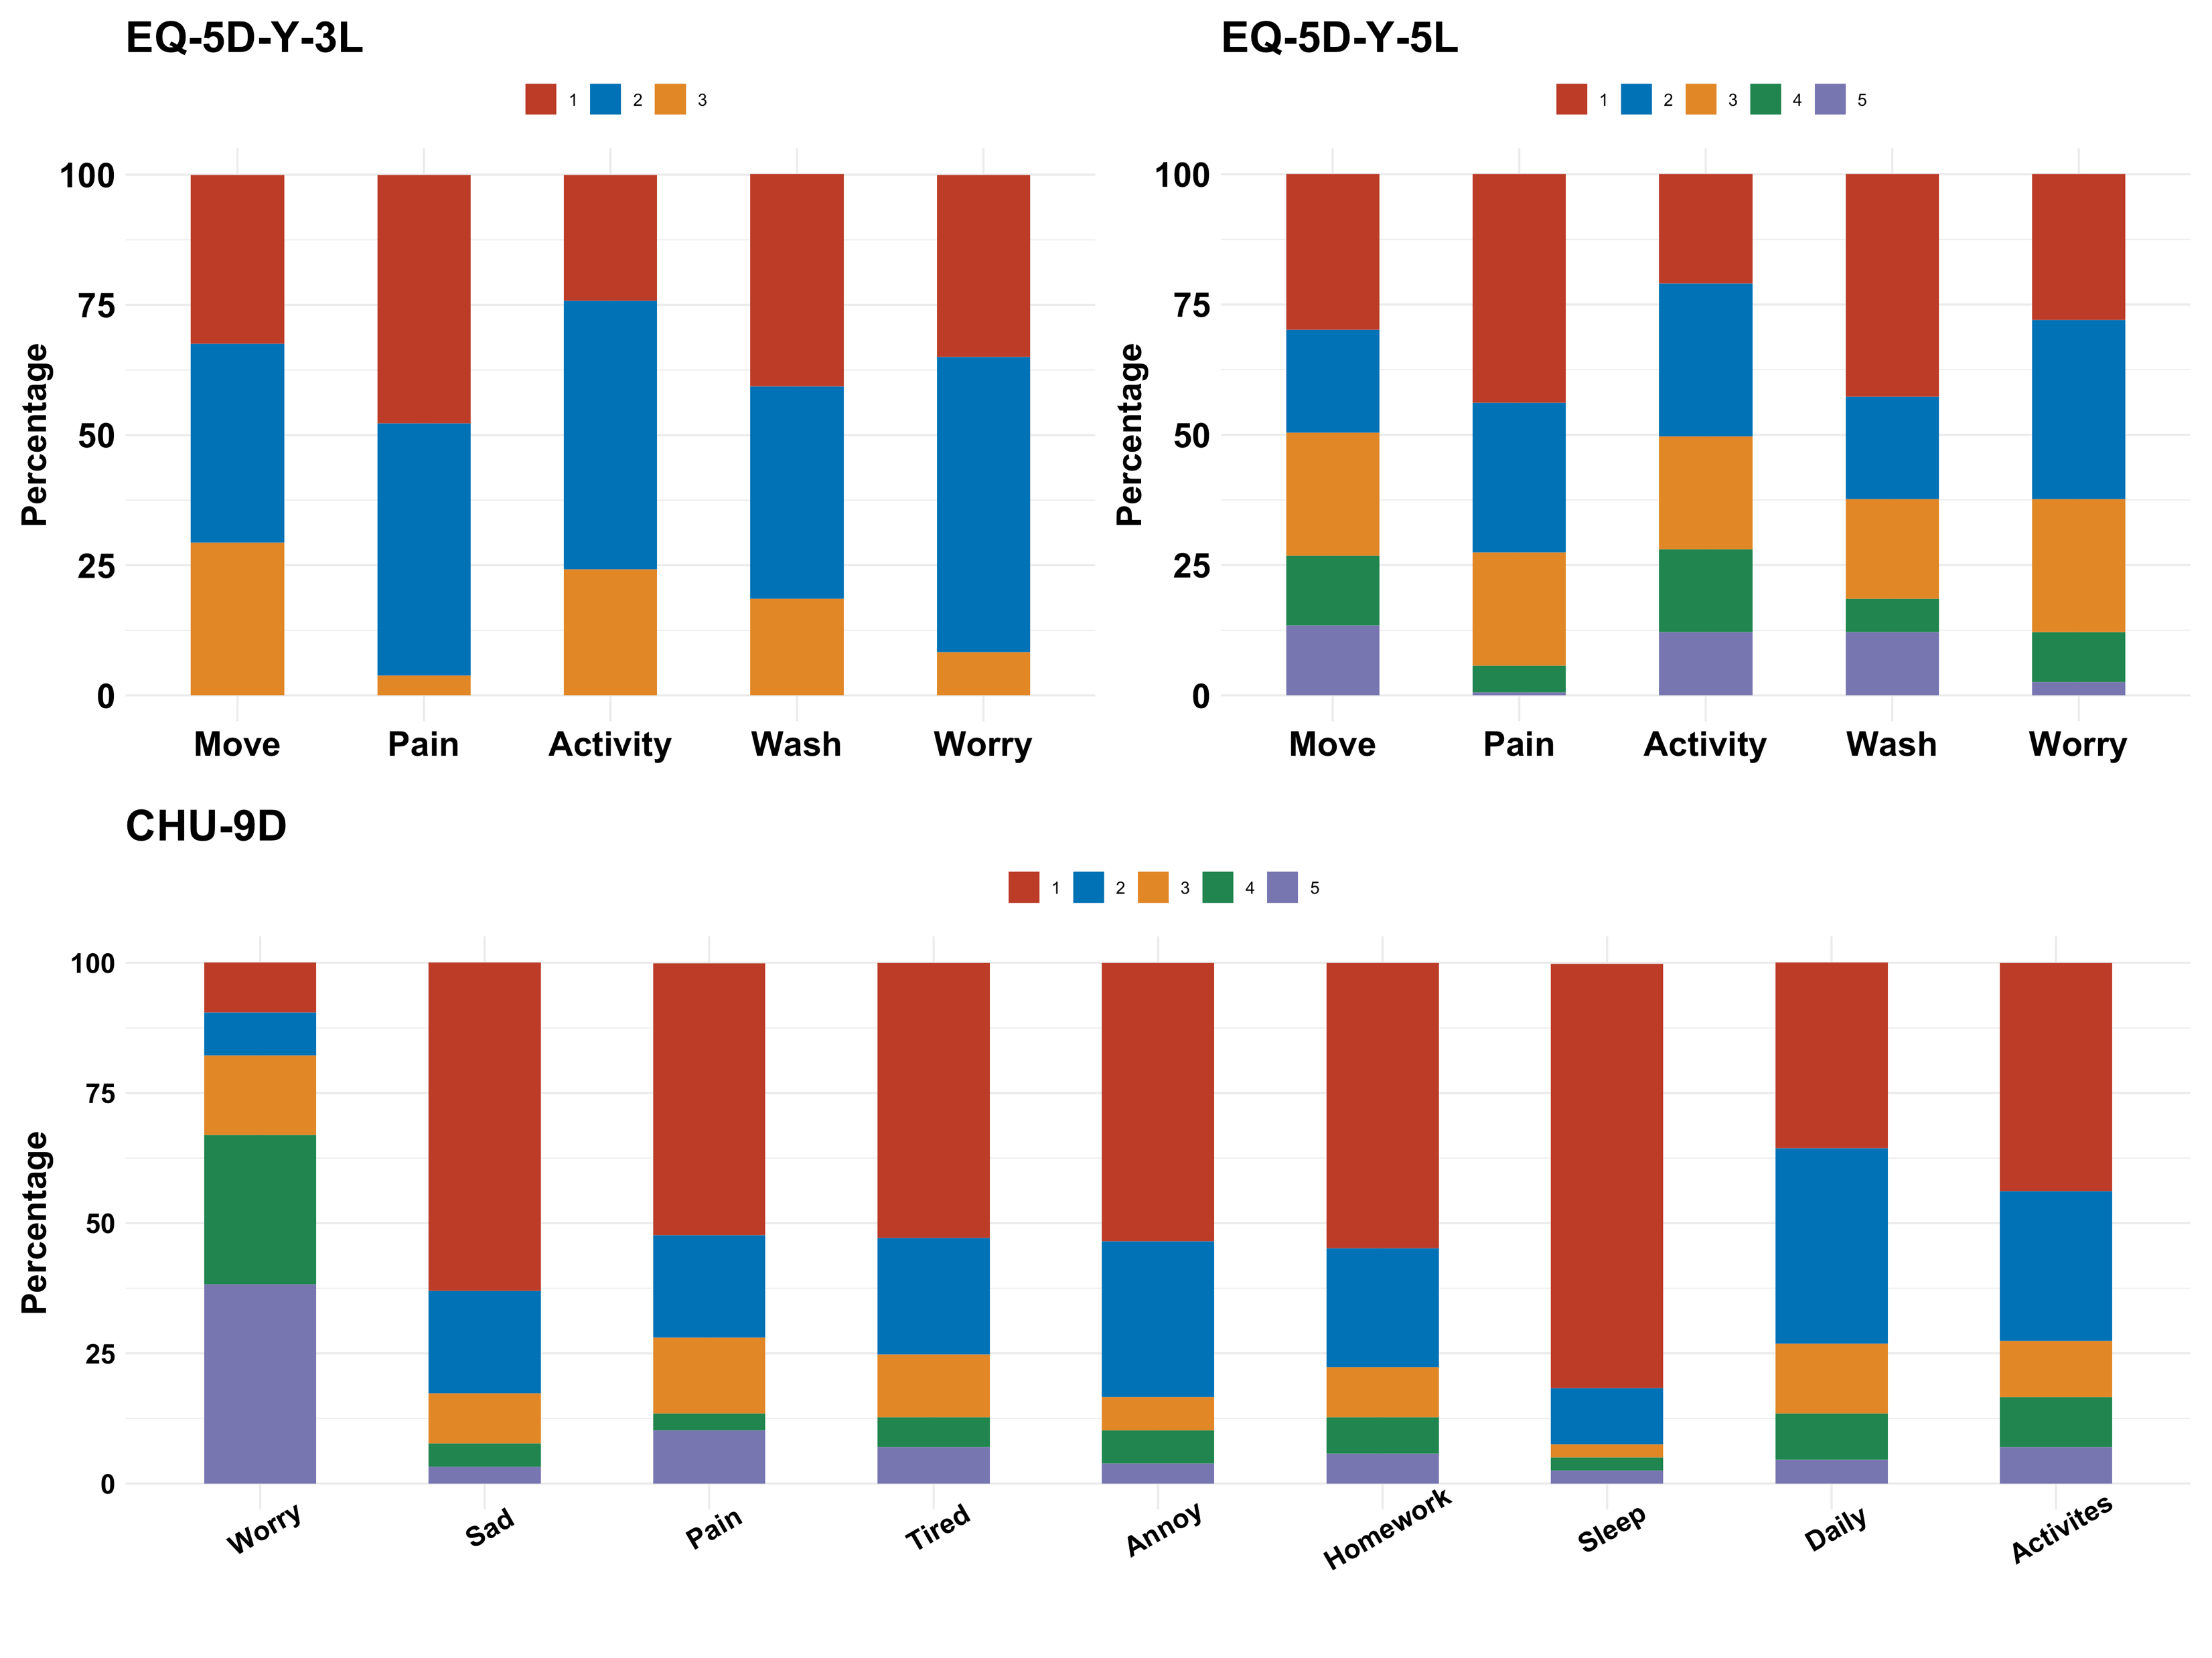
Investigating the Psychometric Properties of the EQ-5D-Y-3L, EQ-5D-Y-5L, and CHU-9D in Children and Adolescents with Osteogenesis Imperfecta
Richard Huan XU¹, Nan LUO², Dong DONG³
1 Department of Rehabilitation Sciences, The Hong Kong Polytechnic University , Hong Kong SAR, China; 2 Saw See School of Public Health, The National University of Singapore, Singapore; 3 JC School of Public Health and Primary Care, The Chinese University of Hong Kong, Hong Kong SAR China
Background and Objective
Osteogenesis imperfecta (OI) is a genetic bone disorder that is present at birth. A child born with OI may have soft bones that break easily, bones that are not formed normally, and other problems, resulting in poor quality of life. However, the performance of pediatric preference-based measures in this population has never been evaluated. The objective of this study is to evaluate the psychometric properties of the EQ-5D-Y (3L and 5L), and CHU-9D in a sample of children and adolescents with OI.
Correlations between the EQ-5D-Y, CHU-9D, and PedsQL
to 0.65 for 3L, 0.31 to 0.56 for 5L, and 0.17 to 0.74 for CHU-9D, confirmed the good test-retest reliability of the EQ-5D-Y and CHU-9D. Both Y-3L and Y-5L showed a better known-group validity than CHU-9D in differentiating patients in different risk groups.
Correlations of dimensions |  |  | Range of coefficients
Y-3L | ↔ | Y-5L | 0.71~0.89
Y-3L | ↔ | CHU-9D | 0.25~0.73
Y-5L | ↔ | CHU-9D | 0.28~0.73
Y-3L | ↔ | PedsQL | -0.25~-0.54
Y-5L | ↔ | PedsQL | -0.23~-0.66
CHU-9D | ↔ | PedsQL | -0.24~-0.60
Methods
A web-based survey of pediatric OI patients was conducted between June and September, 2021. They were recruited from two OI patient organizations in China. Patients were selected based on their family history of OI and/or clinical presentation. Additional inclusion criteria were age between 6 and 18 years and absence of cognitive disability. The construct (convergent and discriminant) and known-group validity were assessed. Test-retest reliability was assessed using data of patients who reported unchanged health status between baseline and follow-up survey (two weeks later). The CHU-9D utility score was estimated using an experimental Chinese value set, and the rescale Level Sum Score (0~1) of the EQ-5D-Y was used as a proxy of utility-based index.
Results
A total of 157 pediatric OI patients participated in the study. A strong ceiling effect was observed for all dimensions of the EQ-5D-Y
(Y-3L:25.8%~47.2%; Y-5L: 21%~43.9% here better to present the % of 11111 for Y and similar % for CHU) and most of the CHU-9D. Both EQ-5D-Y and CHU-9D showed statistically significant correlations with the corresponding PedsQL subscales. A strong correlation was also identified between the Y-3L and Y-5L. The Intraclass correlation coefficient (3L:0.81, 5L:0.79, CHU-9D:0.8, n= 88) and Gwet’s AC2, which ranged between 0.39
 | Y-3L | Y-5L | CHU-9D |  | Y-3L | Y-5L | CHU-9D
Scoliosis |  |  |  | Skeletal deformities
No | 0.65(0.27) | 0.69(0.27) | 0.64(0.18) | No | 0.65(0.26) | 0.70(0.26) | 0.65(0.19)
Yes | 0.54(0.25) | 0.60(0.24) | 0.61(0.18) | Yes | 0.53(0.26) | 0.58(0.24) | 0.60(0.17)
F-statistic | 7.09 | 5.68 | 1.09 | F-statistic | 9.37 | 9 | 2.75
p-value | 0.008 | 0.02 | 0.29 | p-value | 0.003 | 0.003 | 0.1
Foot eversion or inversion |  |  |  | Short stature
No | 0.63(0.26) | 0.68(0.26) | 0.64(0.18) | No | 0.63(0.28) | 0.67(0.28) | 0.62(0.19)
Yes | 0.5(0.26) | 0.57(0.23) | 0.59(0.18) | Yes | 0.57(0.26) | 0.63(0.25) | 0.63(0.18)
F-statistic | 7.22 | 5.48 | 1.9 | F-statistic | 30.94 | 34.77 | 19.4
p-value | 0.008 | 0.02 | 0.17 | p-value | <0.001 | <0.001 | <0.001
Knee Valgus or Varus |  |  |  | Hearing impairment
No | 0.61(0.26) | 0.66(0.26) | 0.63(0.18) | No | 0.60(0.27) | 0.65(0.26) | 0.63(0.18)
Yes | 0.56(0.28) | 0.61(0.26) | 0.61(0.19) | Yes | 0.49(0.17) | 0.52(0.21) | 0.58(0.11)
F-statistic | 4.33 | 1.29 | 0.44 | F-statistic | 4.2 | 4.6 | 0.53
p-value | 0.04 | 0.26 | 0.51 | p-value | 0.04 | 0.03 | 0.46
Known-group validity of the EQ-5D-Y and CHU-9D
Response distribution of the EQ-5D-Y and CHU-9D
Conclusions and Key points
Both the EQ-5D-Y and CHU-9D showed satisfactory psychometric properties in pediatric patients with OI.
The EQ-5D-Y demonstrated a higher sensitivity than CHU-9D to discriminate risk patients, suggesting that it may be more suitable for use in economic evaluation of interventions for OI.
The EQ-5D-Y-3L performed slightly better discriminant ability than the EQ-5D-Y-5L
This study is supported by the EuroQoL Research Foundation (ID: 85-2020RA)

