Slide 1
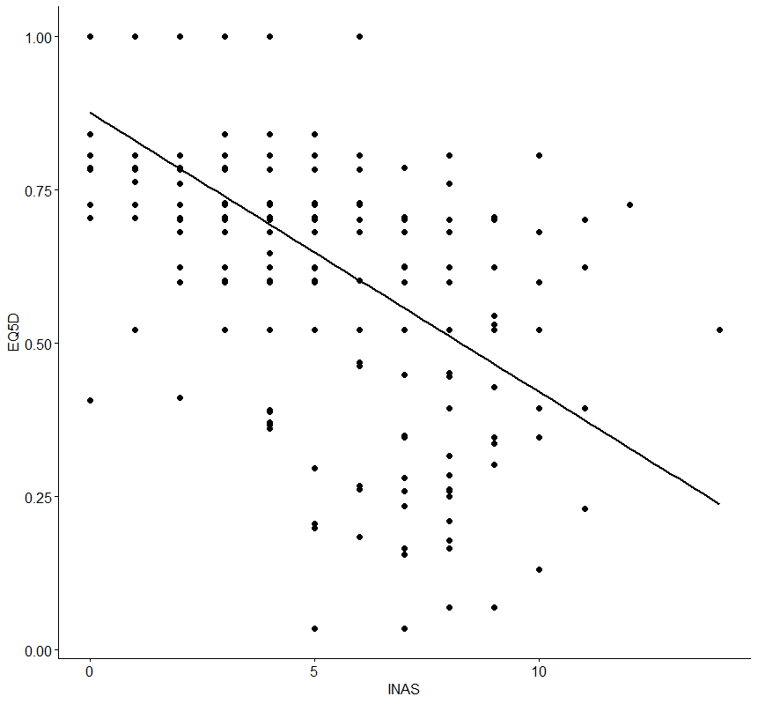
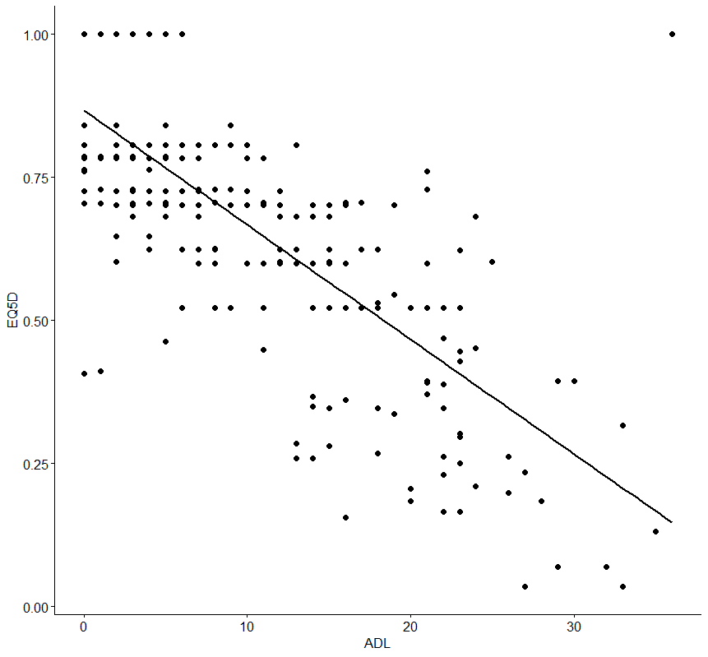
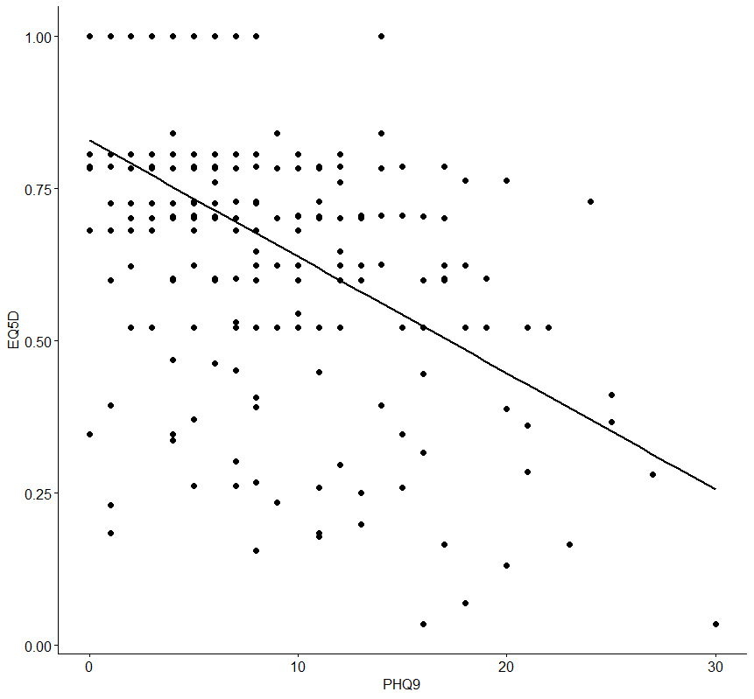
Factors influencing Health-related Quality of Life of Patients with rare spinocerebellar ataxias (SCA)
Niklas Weber, Maresa Buchholz, Anika Rädke, Bernhard Michalowsky
German Center for Neurodegenerative Diseases (DZNE), Rostock/ Greifswald, Germany
O B J E C T I V E
R E S U L T S
To assess the impact of sociodemographic and clinical factors on the progression of SCA patients’ HRQoL using the EQ-5D-3L
EQ-5D-3L indices decreased significantly and steadily over time – the EQ VAS did not constantly demonstrate significant changes.
A higher depression, ataxia severity and age, an earlier onset, a female gender, the SCA Type 1,2 and 3 and the occurrence of a RLS syndrome significantly decrease patients' HRQoL/ the EQ-5D-3L index over time
B A C K G R O U N D
Table 1: Patients‘ Sociodemographic and Clinical Characteristics
Table 3. Factors influencing the decline of the EQ-5D-index over time
Spinocerebellar Ataxias (SCA) are a group of autosomal dominant inherited disorders with a worldwide prevalence of 3/100.000
All SCAs share cerebellum degeneration and progressive neurodegenerative symptoms which cause severe physical disabilities and premature death
There is little knowledge on HRQoL progression and the impact of sociodemographic and clinical factors on patients’ HRQoL in these rare diseases
Age, M±SD | 50.45±13.82
BMI, M±SD | 24.70±4.03
Age of onset, M±SD | 40.38±12.98
EQ-5D-3L index, M±SD | 0.67±0.19
EQ-VAS, M±SD | 64.45±20.01
SARA score, M±SD | 13.25±6.83
INAS count, M±SD | 3.90±2.24
PHQ-9 score, M±SD | 6.91±2.24
Sex, Women, % (n) | 53.19 (183)
RLS symptoms, % (n) | 4.94 (17)
SCA-Type
SCA 1, % (n) | 18.31 (63)
SCA 2, % (n) | 29.07 (100)
SCA 3, % (n) | 33.72 (116)
SCA 6, % (n) | 18.90 (65)
 |  | Baseline to 1-year, 2-year and 3-year follow-up
Parameter | Model | ß (SE) | p-value | CI⁹⁵
Age | 1-year follow-up | -0.004** (0.001) | 0.002 | [-0.007;-0.002]
 | 2-year follow-up | -0.005** (0.001) | 0.001 | [-0.008;-0.002]
 | 3-year follow-up | -0.002 (0.002) | 0.328 | [-0.005;0.002]
Body-Mass-Index | 1-year follow-up | -0.002 (0.002) | 0.220 | [-0.006;0.001]
 | 2-year follow-up | 0.000 (0.002) | 0.996 | [-0.004;0.004]
 | 3-year follow-up | 0.001 (0.002) | 0.790 | [-0.004;0.005]
Female Gender (reference male) | 1-year follow-up | 0.001 (0.015) | 0.927 | [-0.029;0.032]
 | 2-year follow-up | -0.008 (0.017) | 0.647 | [-0.04;0.025]
 | 3-year follow-up | -0.037* (0.018) | 0.039 | [-0.072;-0.002]
Age of Onset | 1-year follow-up | 0.006*** (0.001) | <.0001 | [0.003;0.009]
 | 2-year follow-up | 0.005** (0.002) | 0.001 | [0.002;0.009]
 | 3-year follow-up | 0.004* (0.002) | 0.035 | [0.000;0.007]
Ataxia progression (SARA) | 1-year follow-up | -0.009** (0.003) | 0.004 | [-0.014;-0.003]
 | 2-year follow-up | -0.012*** (0.003) | <.0001 | [-0.018;-0.006]
 | 3-year follow-up | -0.001 (0.003) | 0.730 | [-0.006;0.004]
Change of Non-Ataxia Signs (INAS) | 1-year follow-up | 0.008 (0.005) | 0.106 | [-0.002;0.017]
 | 2-year follow-up | 0.000 (0.004) | 0.935 | [-0.009;0.008]
 | 3-year follow-up | -0.007 (0.005) | 0.117 | [-0.016;0.002]
Change of depression (PHQ-9) | 1-year follow-up | -0.007*** (0.002) | <.0001 | [-0.01;-0.003]
 | 2-year follow-up | -0.007*** (0.002) | <.0001 | [-0.011;-0.004]
 | 3-year follow-up | -0.008*** (0.002) | <.0001 | [-0.012;-0.004]
SCA type 6 (Ref. SCA 1, 2, 3) | 1-year follow-up | 0.045┼ (0.024) | 0.061 | [-0.002;0.092]
 | 2-year follow-up | 0.004 (0.026) | 0.884 | [-0.002;0.092]
 | 3-year follow-up | 0.051┼ (0.027) | 0.061 | [-0.002;0.092]
Restless Legs- | 1-year follow-up | -0.079** (0.036) | 0.028 | [-0.149;-0.009]
Syndrome (RLS) | 2-year follow-up | -0.066┼ (0.026) | 0.087 | [-0.131;0.031]
 | 3-year follow-up | -0.050 (0.041) | 0.227 | [-0.149;-0.009]
R²: 1-year follow-up 0.258, 2-year follow-up 0.244, 3-year follow-up 0.294; all models adjusted for EQ-5D-3L baseline value
Table 2: EQ-5D-3L index and clinical variables over time
M E T H O D S
 |  |  |  | Difference from baseline to
 |  |  |  | 1-year F/Up |  | 2-years F/Up |  | 3-years F/Up
 | Time | mean | SD | mean | SD | mean | SD | mean | SD
EQ-5D-3L-Index | Baseline | 0.67 | 0.19 | -0.02* | 0.15 | -0.04** | 0.16 | -0.05** | 0.16
 | 1-year F/Up | 0.65 | 0.19 |  |  | -0.01** | 0.17 | -0.03** | 0.17
 | 2-years F/Up | 0.64 | 0.21 |  |  |  |  | -0.02 | 0.15
 | 3-years F/Up | 0.63 | 0.20
SARA Score | Baseline | 13.25 | 6.83 | 1.75** | 2.70 | 3.02** | 3.04 | 4.42** | 3.72
 | 1-year F/Up | 14.61 | 6.92 |  |  | 1.27** | 2.21 | 2.67** | 2.90
 | 2-years F/Up | 16.04 | 7.37 |  |  |  |  | 1.40* | 2.44
 | 3-years F/Up | 17.34 | 7.63
INAS Count | Baseline | 3.90 | 2.24 | 0.37** | 1.69 | 0.75** | 1.93 | 1.35** | 2.28
 | 1-year F/Up | 4.18 | 2.25 |  |  | 0.38** | 1.54 | 0.97** | 1.92
 | 2-years F/Up | 4.57 | 2.47 |  |  |  |  | 0.59** | 1.46
 | 3-years F/Up | 5.07 | 2.71
PHQ-9 Score | Baseline | 6.08 | 5.87 | 1.02** | 4.82 | 0.54 | 4.91 | 0.82* | 4.96
 | 1-year F/Up | 6.42 | 5.32 |  |  | -0.48 | 4.8 | -0.20 | 4.48
 | 2-years F/Up | 6.37 | 5.46 |  |  |  |  | 0.27 | 3.66
 | 3-years F/Up | 6.8 | 5.38
EQ VAS | Baseline | 64.45 | 20.01 | -1.53** | 22.47 | -6.17 | 20.32 | -5.58 | 20.668
 | 1-year F/Up | 63.06 | 22.43 |  |  | -4.56 | 21.13 | -3.95 | 20.71
 | 2-years F/Up | 58.15 | 22.55 |  |  |  |  | 0.26 | 17.34
 | 3-years F/Up | 58.73 | 20.82
Data Set:
Patients with SCA 1,2,3 and 6 were recruited from the European integrated project on spinocerebellar ataxias (EUROSCA) and the European SCA3/ Machado-Joseph Diseases Initiative (ESMI)
Sample of 344 patients with full baseline data were included. Patients completed a battery of HRQoL (EQ-5D-3L and EQ-VAS) and the following clinical questionnaires: SARA (Scale for Assessment and Rating of Ataxia, INAS (Inventory of Non-Ataxia Signs), depression severity: PHQ-9 (Patient Health Questionnaire 9), restless leg syndrome (RLS)
Statistical analysis
EQ-5D-3L utility indices were calculated with the European value set (Greiner et al. 2003)
Multivariate regression models for the one-, two- and three-year follow-up were performed using multiple linear regression models adjusted for EQ-5D-3L baseline index
M A I N T A K E A W A Y S
EQ-5D-3L seems to be a valid instrument to demonstrate the impact of patients’ sociodemographic (age, onset, gender) and clinical characteristics (ataxia severity, depression, RLS) on patients’ HRQoL in rare Spinocerebellar Ataxia Diseases (SCA).
Thus, the EQ-5D-3L could be routinely used in clinical trials and practice to assess patients HRQoL and identify predicting factors of HRQoL for shared decision-making, respectively.
Without a care, treatments of patients’ depression and RLS symptoms, should be initiated to improve patient-reported outcomes in patients with SCA disorders, especially in female patients with SCA 1,2 and 3 and with an early onset of the disease.
R E F S
Jacobi H, du Montcel S T, Bauer P et al. (2015). Long-term disease progression in spinocerebellar ataxia types 1, 2, 3, and 6: a longitudinal cohort study. Lancet Neurol, 14(11), 1101-1108, Schmitz‐Hübsch T, Coudert M, Giunti P et al. (2010). Self‐rated health status in spinocerebellar ataxia—Results from a European multicenter study. Movement disorders, 25(5), 587-595. Jacobi H, Scharbian T, Beyersmann J et al. (2022) Evolution of disability in spinocerebellar ataxias type 1,2,3 and 6; Annals of Clinical and Translational Neurology; 9(3): 286-295; Greiner, Wolfgang et al (2003). A single European currency for EQ-5D health states. The European Journal of Health Economics. 4. 222-231.

