Slide 1
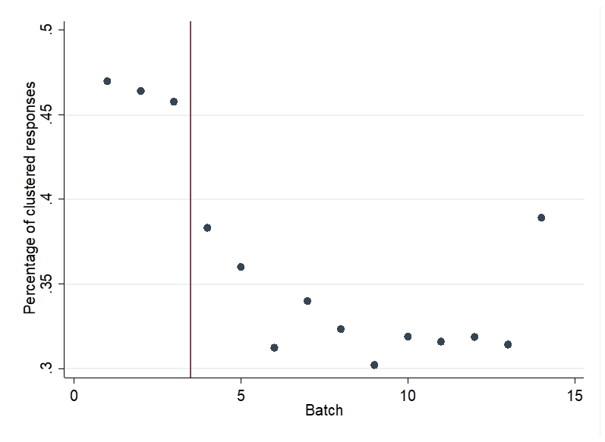
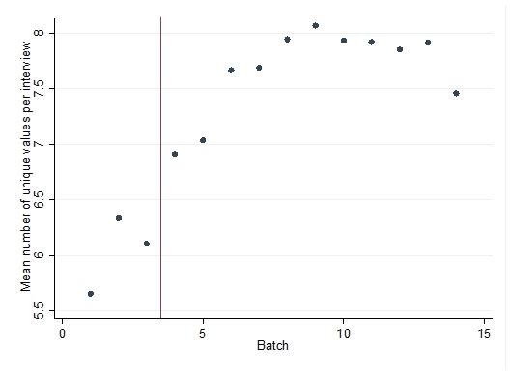
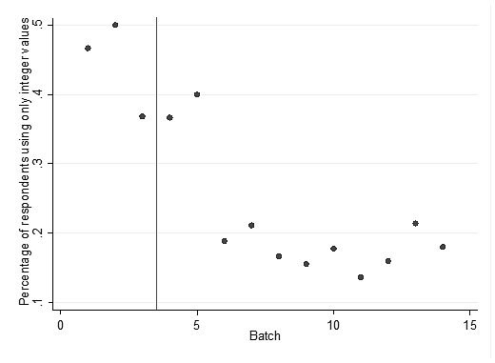
An Extensive Pilot Phase in the Egyptian EQ-5D-5L Valuation Study - Lessons Learned
Samar Farid ¹, PhD, Sahar Al Shabasy ¹ ,PhD, Bram Roudijk, PhD, Maggie Abbassi¹, PhD, Aureliano Finch², PhD and Elly Stolk², PhD
¹ Department of Clinical Pharmacy, Faculty of Pharmacy, Cairo University, Cairo, Egypt
² EuroQol Research Foundation, Rotterdam, The Netherlands
OBJECTIVES
RESULTS
RESULTS
To investigate the effect of an extensive pilot phase in improving protocol compliance, face validity, and reduction of interviewers’ effect and prediction errors in the cTTO data.
To investigate how interviewer performance evolved during the EQ-5D-5L valuation study in Egypt.
1180 interviews were conducted by nine interviewers and included in the final analysis, of which 206 interviews were pilot and 974 interviews were real.
Figure 4: MAE per respondent per interviewer over the sequence of interviews
Figure 1: Percentage of clustered responses (A) and mean number of unique values per interview (B) per batch (pilot and real data, left and right of the vertical line, respectively)
A
B
METHODS
This study used the collected cTTO data and QC reports of the Egyptian EQ-5D-5L valuation study.
Three-level mixed models were estimated to test whether interviewer effects were reduced during the pilot phase and subsequent rounds of collected cTTO data.
Ordinary least square (OLS) regression analysis was conducted for each interviewer separately to test whether the MAE improved as interviewers completed more interviews.
Improvement in protocol compliance, face validity and reduction of prediction errors in the cTTO data were tested.
Figure 2: Percentage of respondents using only integer values (A) mean absolute error (MAE) (B) per batch (pilot and real data, left and right of the vertical line, respectively)
IMPLICATIONS
A
B
Achieving the minimum quality control requirements is not enough to guarantee good data quality.
Implementing an extensive pilot may substantially improve the face validity and predictive accuracy of the data collected in the actual data collection phase, but is costly.
We recommend implementing an extensive pilot especially for the EQ-5D-5L valuation studies that have issues initially with protocol compliance and interviewer effects.
Figure 3: MAE’s for 10,000 random draws of 1000 respondents completing all 10 cTTO tasks
EMAIL: samar.farid@pharma.cu.edu.eg

