Slide 1
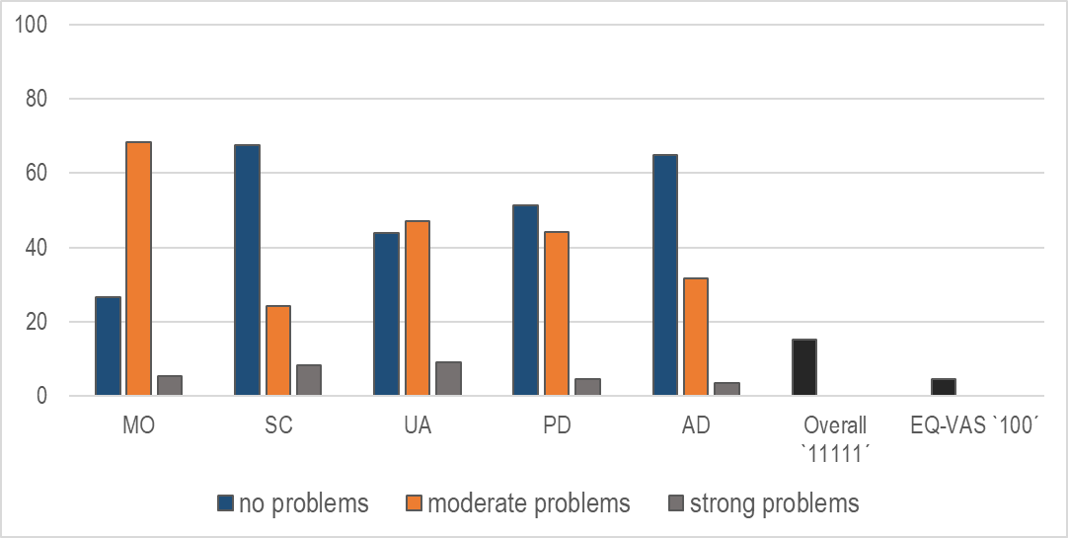
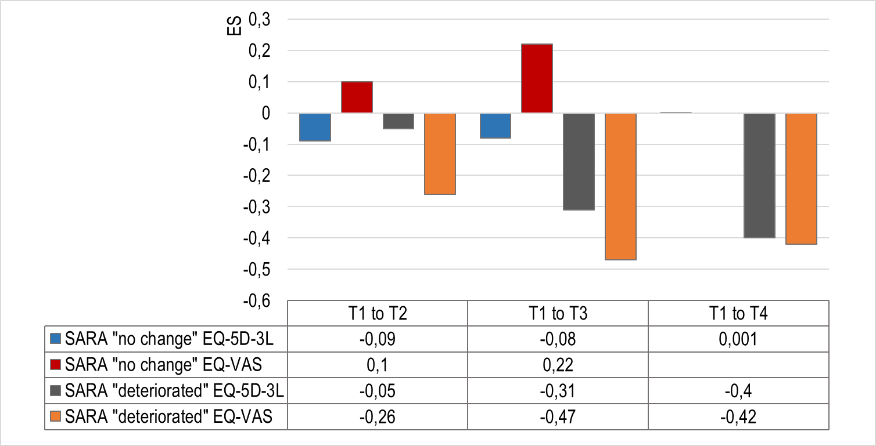
Psychometric properties of the EQ-5D-3L in patients with rare Spinocerebellar ataxia type 3 (SCA3): Acceptability, validity and responsiveness
Maresa Buchholz¹, Niklas Weber¹, Feng Xie^{2,3}, Anika Rädke¹, Thomas Klockgether^{4,}, Bernhard Michalowsky¹
¹German Center for Neurodegenerative Diseases (DZNE), Rostock/ Greifswald, Germany^{; 2} Program for Health Economics and Outcome Measures (PHENOM), Hamilton, Canada; ³Department of Health Research Methods, Evidence and Impact (formerly Clinical Epidemiology and Biostatistics), McMaster University, Canada; ⁴ German Center for Neurodegenerative (DZNE), Bonn, Germany
O B J E C T I V E
R E S U L T S
To assess the psychometric performance of the
EQ-5D-3L in SCA 3
Table 1: Patient characteristics
Figure 1: Distribution of responses and ceiling effects
Missing values < 3 % for EQ-5D-3L index
EQ-5D-3L & EQ-VAS correlate moderate to strong with PHQ-9 and ataxia severity
EQ-5D-3L differentiated between stages of age, ataxia severity, ADL and INAS
EQ-5D-3L and EQ-VAS show small to moderate changes in health regarding ataxia severity
Sex, % women | 51.6
Age, M±SD | 48.3±12.6
EQ-5D-3L, M±SD | 0.68±0.22
EQ-VAS, M±SD | 66.7±21.4
B A C K G R O U N D
Rare spinocerebellar ataxia type 3 (SCA3):
most common autosomal inherited ataxia disorder with a progressive course
estimated prevalence worldwide 1/100.000
age of onset: around 35 years
clinical features are muscle weakness, sensory loss, coordination problems and limited cognitive health, tremendously affecting patients’ HRQoL
Little is known about psychometric performances of HRQoL instruments in SCA 3 patients
Table 2: Known-groups validity
Age | EQ-5D-3L | p-value
< 49 years old | 0.72±0.22 | <0.01
> 49 years old | 0.64±0.21
SARA score
Mild 0-9.5 | 0.80±0.16 | <0.01
Moderate ≤19.5 | 0.66±0.14
Strong ≤29.5 | 0.43±0.20
Extreme ≤40 | 0.30±0.27
INAS count
≤ 4 Symptoms | 0.77±0.16 | <0.01
> 4 Symptoms | 0.54±0.22
PHQ-9 score
Mild 0-4 | 0.75±0.19 | <0.01
Moderate ≤9 | 0.56±0.20
CONCLUSION
Table 3: Construct validity of EQ-5D-3L and EQ-VAS
Understanding the psychometric performance of HRQoL instruments in this rare, progressive Ataxia disorders (SCA 3) is crucial for future economic evaluation of innovative (curative) treatments.
Our psychometric results satisfy acceptability, discriminatory ability, convergent validity and responsiveness of the EQ-5D-3L in patients with SCA.
The EQ-5D-3L could, therefore, be used in economic evaluations in Ataxia diseases (SCA 3).
M E T H O D S
EQ-5D-3L | r_{sp} | p-value | EQ-VAS | r_{sp} | p-value
SARA | -0.697 | <0.01 | SARA | -0.473 | <0.01
ADL | -0.770 | <0.01 | ADL | -0.504 | <0.01
INAS | -0.596 | <0.01 | INAS | -0.325 | <0.01
PHQ-9 | -0.520 | <0.01 | PHQ9 | -0.415 | <0.01
Data are given as Spearman´s correlation coefficient (r_{sp})
Data base (ESMI):
The following sociodemographic, clinical and HRQoL data were assessed from SCA 3 patients recruited from the European SCA3/ Machado-Joseph Disease Initiative (ESMI)
HRQoL: EQ-5D-3L (European value set, Greiner et al. 2003)
Clinical Variables: SARA (Scale for Assessment and Rating of Ataxia), INAS (Inventory of Non-Ataxia Signs), ADL (Activities of Daily Living), PHQ-9 (Patient Health Questionnaire)
Figure 2: Effect Sizes (ES) of EQ-5D-3L Index Scores and EQ-VAS
*
R E F E R E N C E S
Distribution/ acceptability
Score range, mean, standard deviation, floor and ceiling effects
Missing values
Validity
Construct validity: Correlations coefficients between EQ-5D-3L/ EQ-VAS & SARA, ADL, INAS and PHQ-9
Known-groups validity regarding SARA, ADL, INAS and PHQ-9
Responsiveness
Sample categorized according to “no change” and “deterioted“ ataxia severity (SARA)
Calculating of Effect Size (ES) Cohens d
*
*
Greiner W, Weijnen T, Nieuwenhuizen, M et al. (2003). A single European currency for EQ-5D health states. The European Journal of Health Economics, formerly: HEPAC, 4(3), 222-231.
Jacobi H, du Montcel S T, Bauer P et al. (2015). Long-term disease progression in spinocerebellar ataxia types 1, 2, 3, and 6: a longitudinal cohort study. Lancet Neurol, 14(11), 1101-1108.;
Maas R P, Schutter D J, van de Warrenburg B P (2021). Discordance Between Patient-Reported Outcomes and Physician-Rated Motor Symptom Severity in Early-to-Middle-Stage Spinocerebellar Ataxia Type 3. The Cerebellum, 20(6), 887-895.;
Schmitz‐Hübsch T, Coudert M, Giunti P et al. (2010). Self‐rated health status in spinocerebellar ataxia—Results from a European multicenter study. Movement disorders, 25(5), 587-595.
*
*
*
SARA “no change”: identical SARA score from T1 to T2; T1 to T3 and T1 to T4.; SARA “deteriorated”: worsening of SARA score from T1 to T2; T1 to T3 and T1 to T4.; * p ≤0.05

