Slide 1

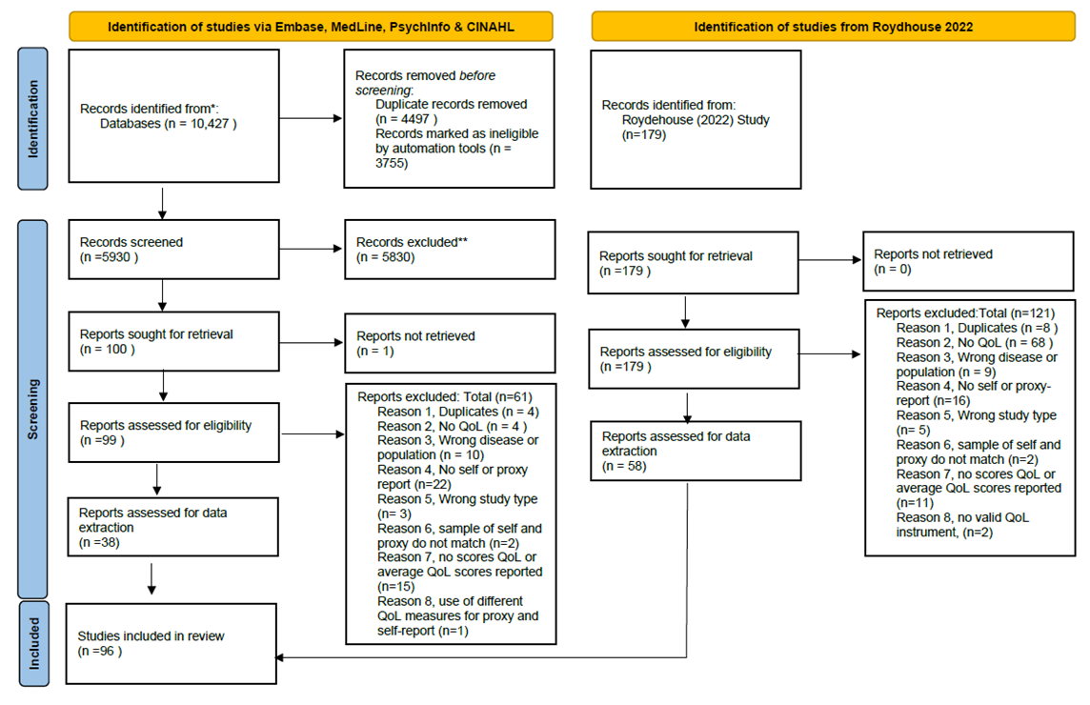
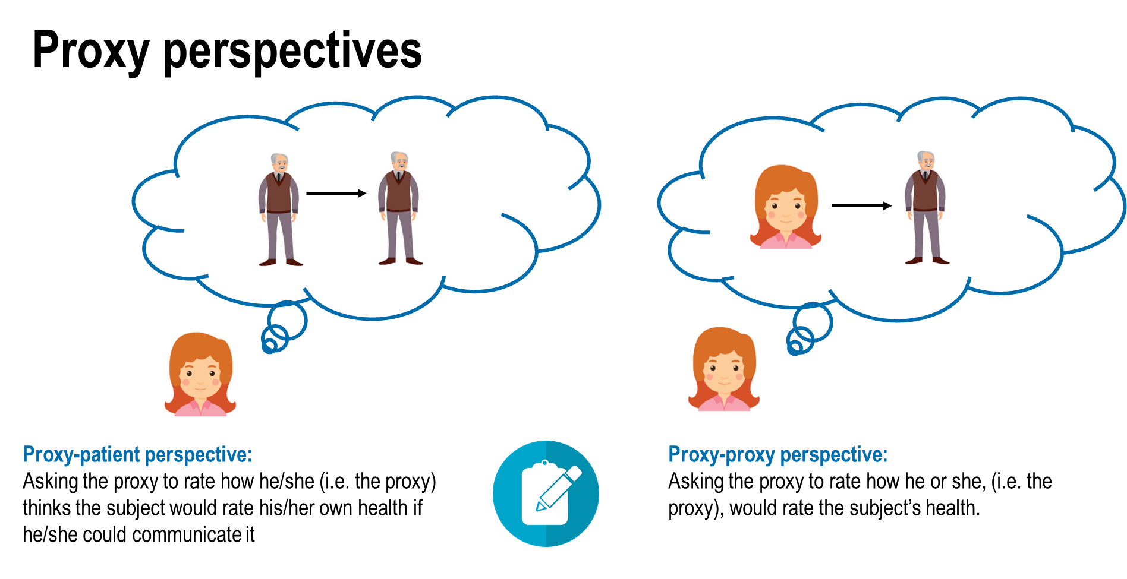
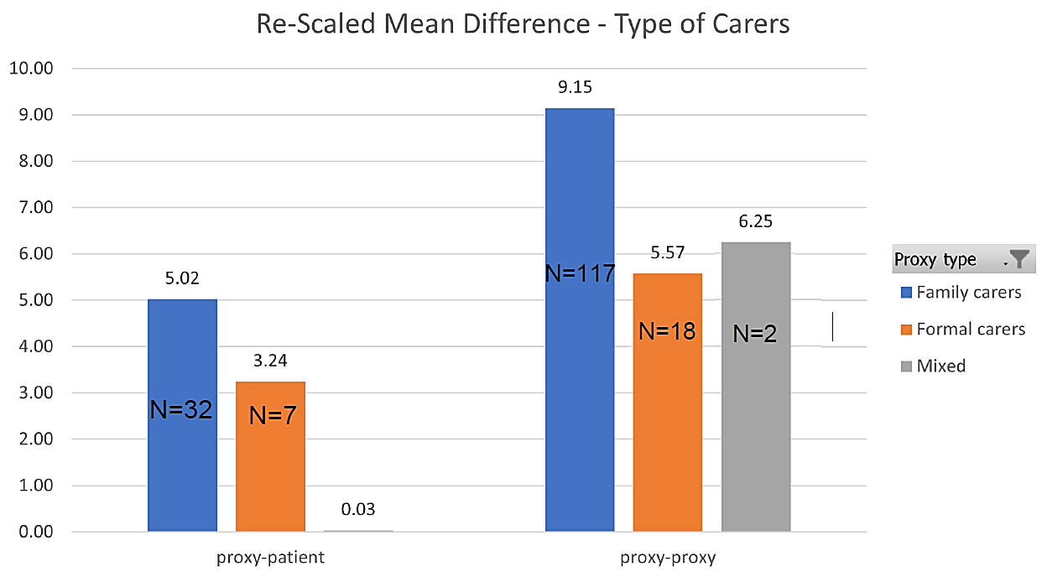
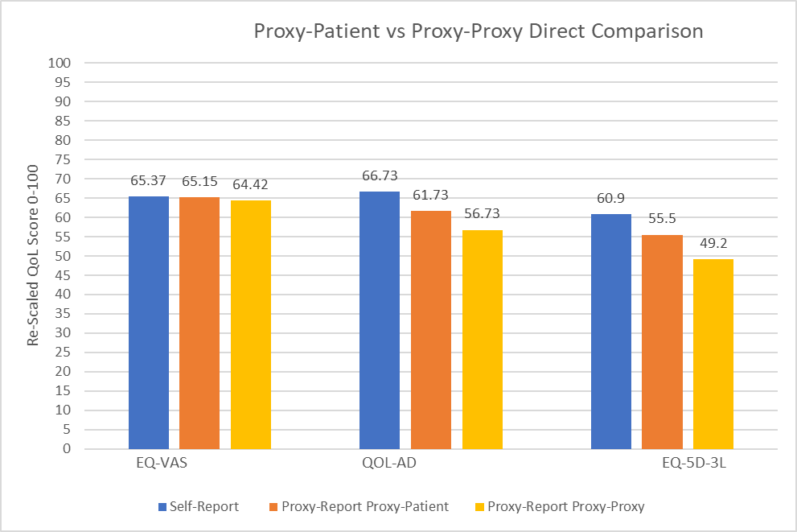
Understanding the influence of different proxy perspectives in explaining the difference between self-report and proxy report when assessing quality of life in people living with dementia: a systematic literature review
Lidia Engel,¹ Anna Leuenberger,² Kat Bogatyreva^{1,2}
1. School of Public Health and Preventive Medicine, Monash University, Melbourne, Victoria, Australia.
2. School of Health and Social Development, Deakin University, Burwood, Victoria, Australia.
Objective
Previous research has highlighted a gap between self-report and proxy-report quality of life (QoL) assessments.
It is currently unknown how the respective proxy-perspective adopted contributes to the disagreement.
The aim of this study was to undertake a literature review to identify the role of the different proxy-assessment perspectives in explaining differences between self-rated and proxy-rated QoL in people living with dementia.
Results:
In total, 96 studies were included in this review and a total of 649 observations were extracted
Table 1: Overview of number of studies (observations) by instruments
 | Proxy-proxy | Proxy-patient | Undefined
DEMQOL |  | 12 (25)
DEMQOL-U |  | 3 (5)
DUKE |  | 1 (2)
EQ-5D |  |  | 2 (3)
EQ-5D-3L | 2 (12) | 2 (6) | 12 (24)
EQ-5D-5L | 1(2) |  | 6(14)
EQ-VAS | 2 (4) | 1 (3) | 8 (15)
HUI-3 |  |  | 1 (1)
ICECAP-O |  |  | 2 (4)
QOL-AD 13 Item | 63 (121) | 3 (5) | 1 (1)
QOL-AD 10 Item | 1 (3)
QOL-AD 12 Item | 1 (1)
QOL-AD 15 Item | 4 (8)
QWB |  |  | 1 (1)
SF-12 MSC |  |  | 1 (1)
SF-12 PCS |  |  | 1 (1)
Bosboom et al (2012) | 2 (6)
Leontjevas et al (2016)
Figure 2: PRISMA flow diagram
Table 2: Weighted and re-scaled self- and proxy-scores
 | Proxy-proxy |  |  |  | Proxy-patient |  |  |  | Undefined
 | N* | Self | Proxy | MD^ | N* | Self | Proxy | MD^ | N* | Self | Proxy | MD^
DEMQOL |  |  |  |  | 12 (25) | 73.76 | 70.26 | 3.50
DEMQOL-U |  |  |  |  | 3 (5) | 88.26 | 74.36 | 13.90
Duke |  |  |  |  | 1 (2) | 54.84 | 47.98 | 6.86
EQ-5D |  |  |  |  |  |  |  |  | 2 (3) | 53.29 | 34.20 | 19.09
EQ-5D-3L | 2 (12) | 67.26 | 53.62 | 13.64 | 2 (6) | 62.39 | 55.32 | 7.07 | 12(24) | 76.65 | 58.00 | 18.65
EQ-5D-5L | 1(2) | 86.1 | 61.53 | 24.57 |  |  |  |  | 6 (14) | 79.75 | 62.78 | 16.97
EQ-VAS | 2 (4) | 69.32 | 64.05 | 5.27 | 1 (3) | 65.37 | 65.5 | 0.22 | 8 (15) | 71.50 | 60.52 | 10.99
HUI-3 |  |  |  |  |  |  |  |  | 1 (1) | 73 | 23 | 50
ICECAP-O |  |  |  |  |  |  |  |  | 2 (4) | 42.07 | 41.14 | 0.93
QOL-AD-13 | 63 (121) | 68.46 | 60.58 | 7.89 | 3 (5) | 72.26 | 70.09 | 2.17 | 1 (1) | 58.46 | 52.42 | 6.04
QOL-AD-10 | 1 (3) | 89.53 | 74.30 | 15.24
QOL-AD-12 | 1 (1) | 72.31 | 59.19 | 13.13
QOL-AD-15 | 4 (8) | 67.05 | 55.05 | 12.00
QWB |  |  |  |  |  |  |  |  | 1 (1) | 60 | 42 | 18
SF-12 PCS |  |  |  |  |  |  |  |  | 1 (1) | 45.74 | 42.02 | 3.72
SF-12 MSC |  |  |  |  |  |  |  |  | 1 (1) | 49.38 | 49.27 | 0.11
Total | 74 (151) | 74.29 | 61.19 | 13.11 | 22 (46) | 69.48 | 63.92 | 5.62 | 35 (65) | 60.98 | 46.54 | 14.50
Figure 1: Overview of different proxy perspectives
Methods
This review used two approaches to identify relevant studies:
Primary studies were obtained from a recent review (Roydhouse et al. 2021) that measured QoL (self- and proxy-report) of people living with dementia.
An update of the review was undertaken in four bibliographic databases (MEDLINE, EMBASE, CINAHL, PsycINFO)
Inclusion criteria:
Peer-reviewed journal articles in English language
Reported both self-reported and proxy-reported QoL scores
Used validated QoL instruments
Measured QoL of people living with dementia
Data extraction and synthesis:
Key characteristics extracted using a template
QoL scores were re-scaled on a common 0-100 scale and weighted by sample size
Figure 3: Rescaled scores by proxy type
Table 3: Intra-proxy gap based on two studies of direct comparison
 | proxy-proxy | proxy-patient | Intra-Proxy Gap | Re-scaled Gap
QOL-AD | 29.5 | 32.1 | 2.6 | 5
EQ-VAS | 64.42 | 65.15 | 0.73 | 0.73
EQ-5D-3L | 0.492 | 0.555 | 0.063 | 6.3
N*= number of studies (number of observations); MD^ = mean difference between self-and proxy-report
Conclusion:
Adopting a proxy-proxy perspective has a higher inter-rater gap in comparison to the proxy-patient perspective. This review highlights the need for more transparent reporting around which perspective is used, especially when using the EQ-5D measures, which have both (proxy-proxy and proxy-patient) perspectives available.
Figure 4: Direct comparison of perspectives based on two studies
Contact details: lidia.engel@monash.edu

